Slide 1
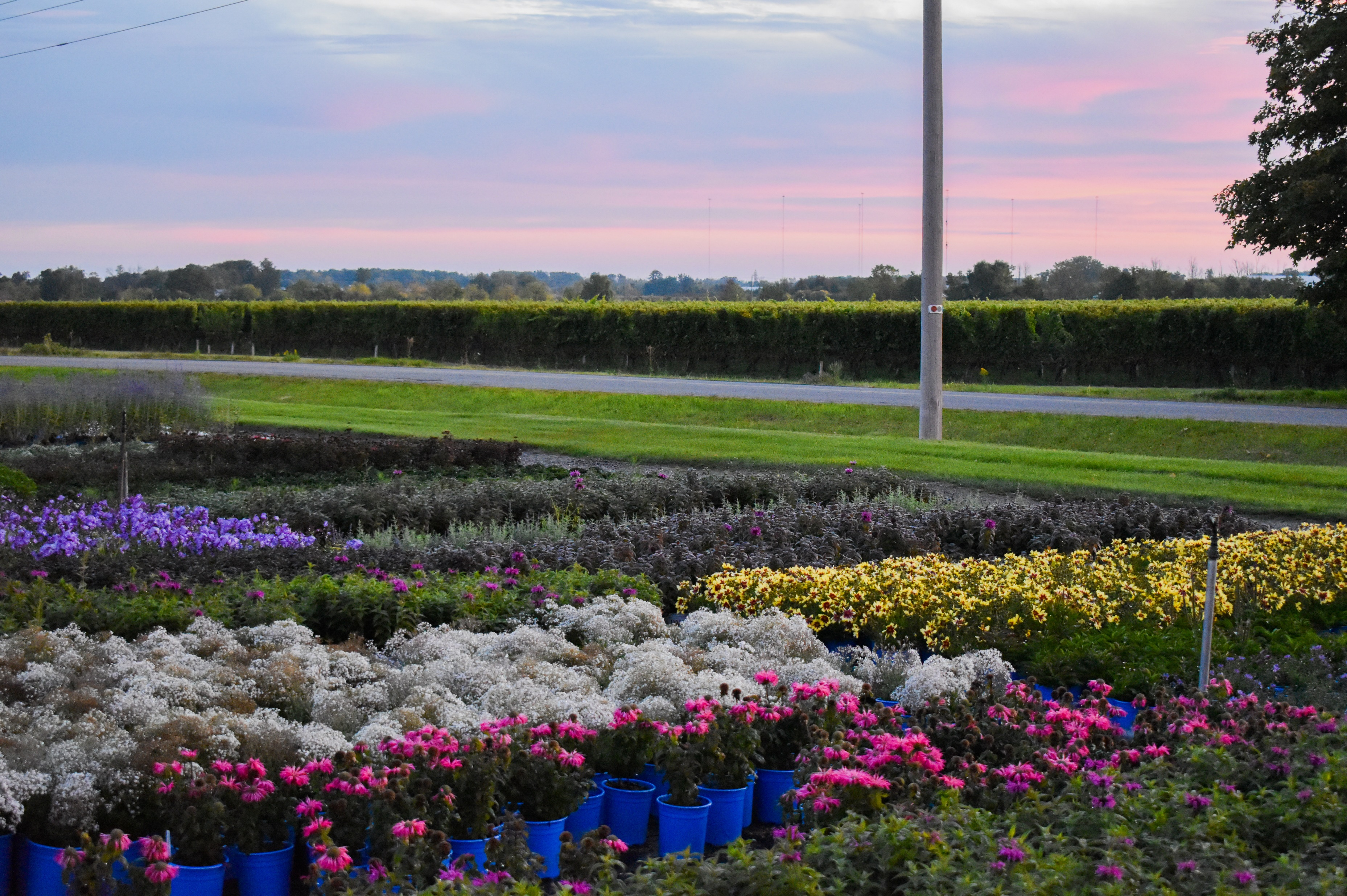
Blue Sky Nursery
L I M I T E D
NEW Plants 2025

Slide 2


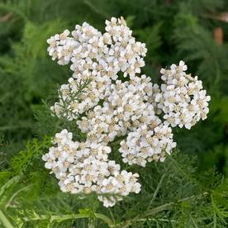
New
Perennial
Beamsville, ON
NATIVE
Achillea
millefolium
(White Yarrow)
Photo courtesy of North Creek Nurseries

Slide 3
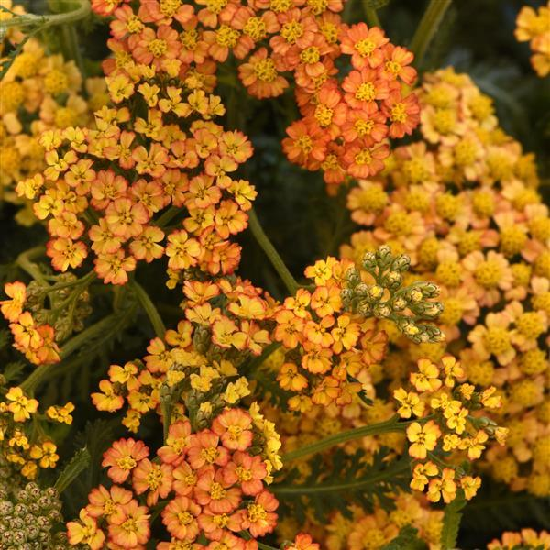
New
Perennial
Beamsville, ON
Achillea
millefolium
MILLY ROCK™ YELLOW TERRACOTTA
(Yarrow)
Photo Courtesy of Ball horticultural Company

Slide 4
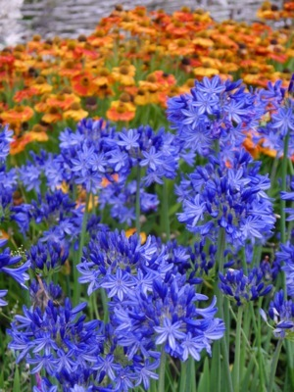
New
Perennial
Beamsville, ON
Agapanthus
NORTHERN STAR
(Lily of the Nile)
Photo courtesy of Paridon Horticultural Ltd.

Slide 5
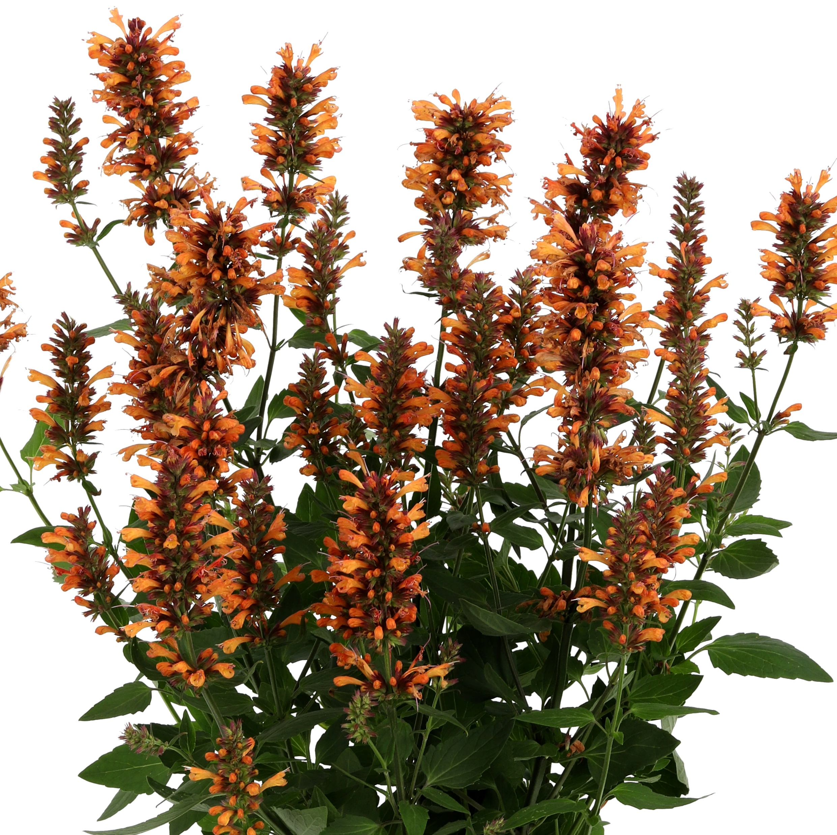
New
Perennial
Beamsville, ON
Agastache
HONEYSTICKS EMBER
(Giant Hyssop)
Photo courtesy of Ball Horticultural Company

Slide 6
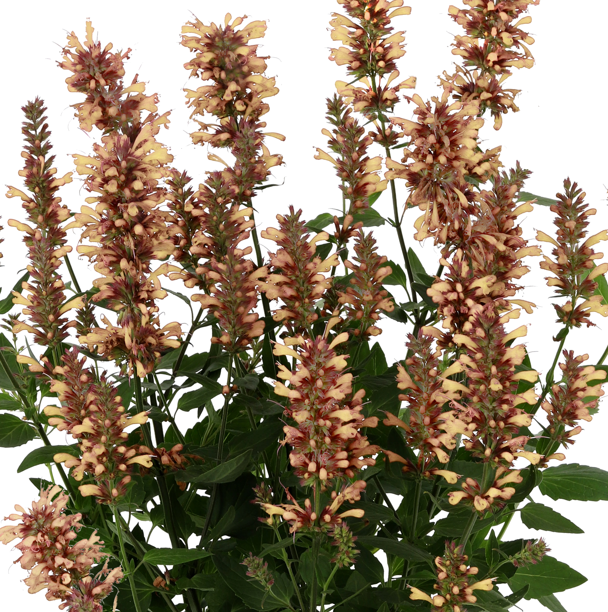
New
Perennial
Beamsville, ON
Agastache
HONEYSTICKS SANDSTONE
(Giant Hyssop)
Photo courtesy of Ball Horticultural Company

Slide 7
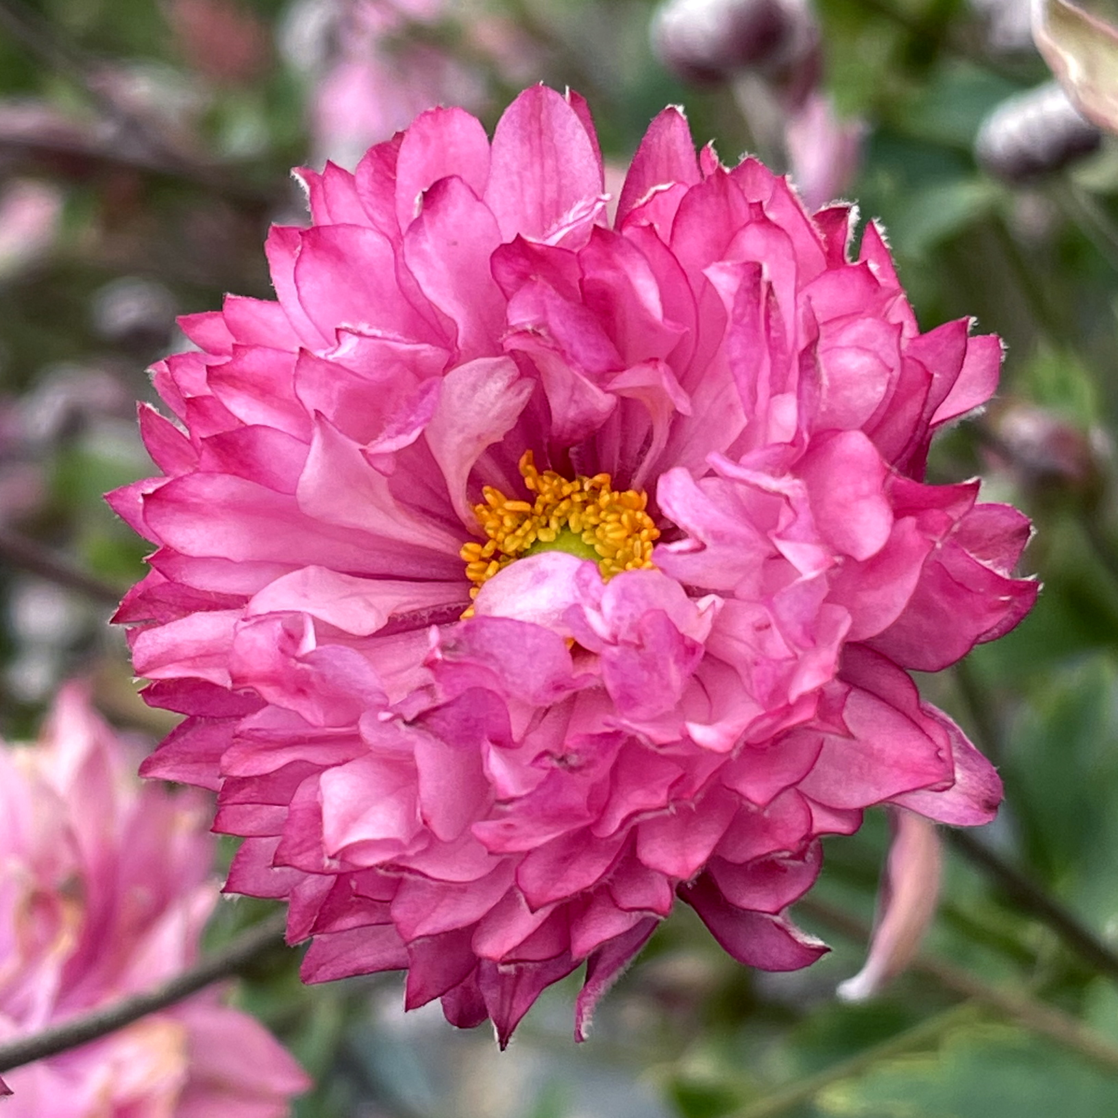
New
Perennial
Beamsville, ON
Anemone
simplex
PUFF® PINK
(Wind Flower)
Photo courtesy of Terra Nova® Nurseries, Inc.

Slide 8
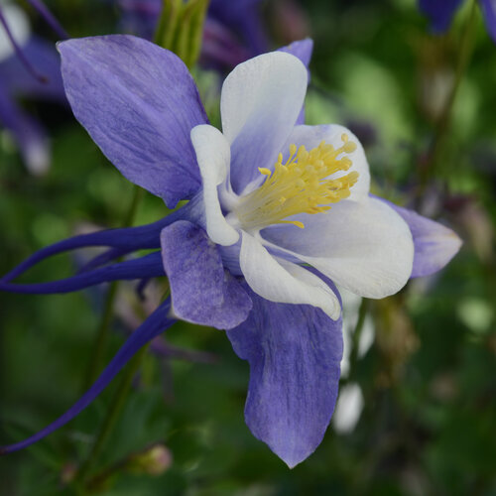

New
Perennial
Beamsville, ON
Aquilegia
EARLYBIRD™
BLUE WHITE
(Columbine)
Photo Courtesy of Proven Winners

Slide 9
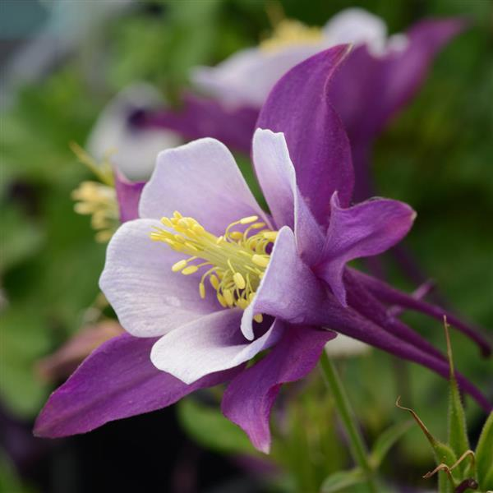
New
Perennial
Beamsville, ON
Aquilegia
EARLYBIRD™
PURPLE WHITE
(Columbine)
Photo courtesy of Ball Horticultural Company

Slide 10
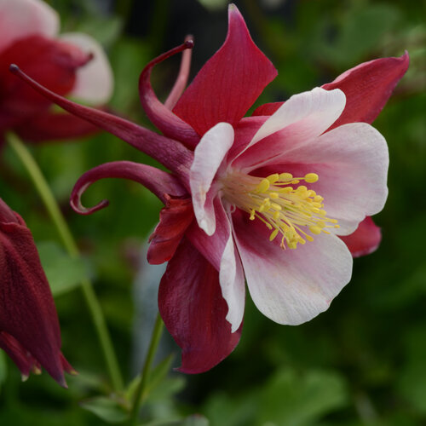
New
Perennial
Beamsville, ON
Aquilegia
EARLYBIRD™
RED WHITE
(Columbine)
Photo courtesy of Proven Winners

Slide 11
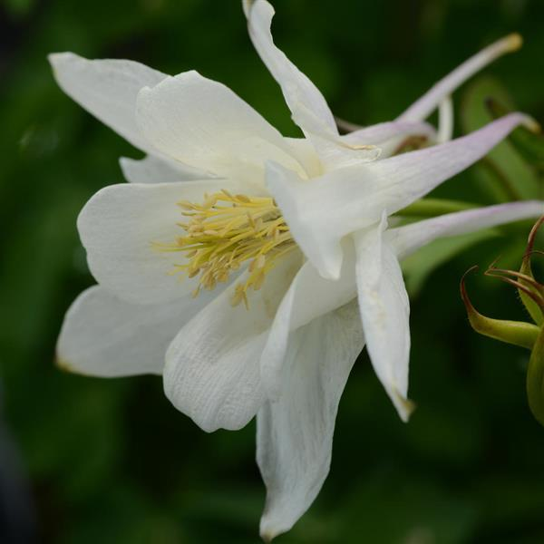
New
Perennial
Beamsville, ON
Aquilegia
EARLYBIRD™
WHITE
(Columbine)
Photo courtesy of Ball Horticultural Company

Slide 12
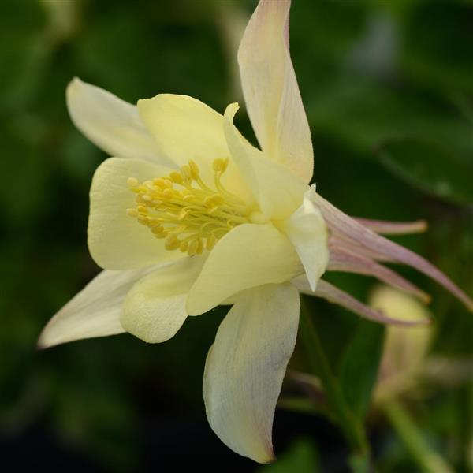
New
Perennial
Beamsville, ON
Aquilegia
EARLYBIRD™
YELLOW
(Columbine)
Photo courtesy of Ball Horticultural Company

Slide 13
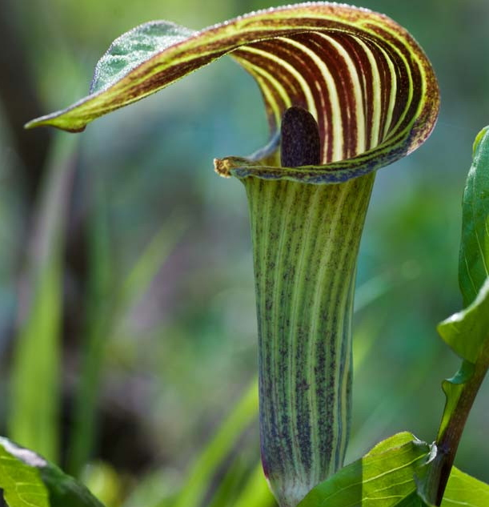
New
Perennial
Beamsville, ON
NATIVE
Arisaema
triphyllum
(Jack-in-the-Pulpit)
Photo courtesy of Gardenia Creating Gardens

Slide 14
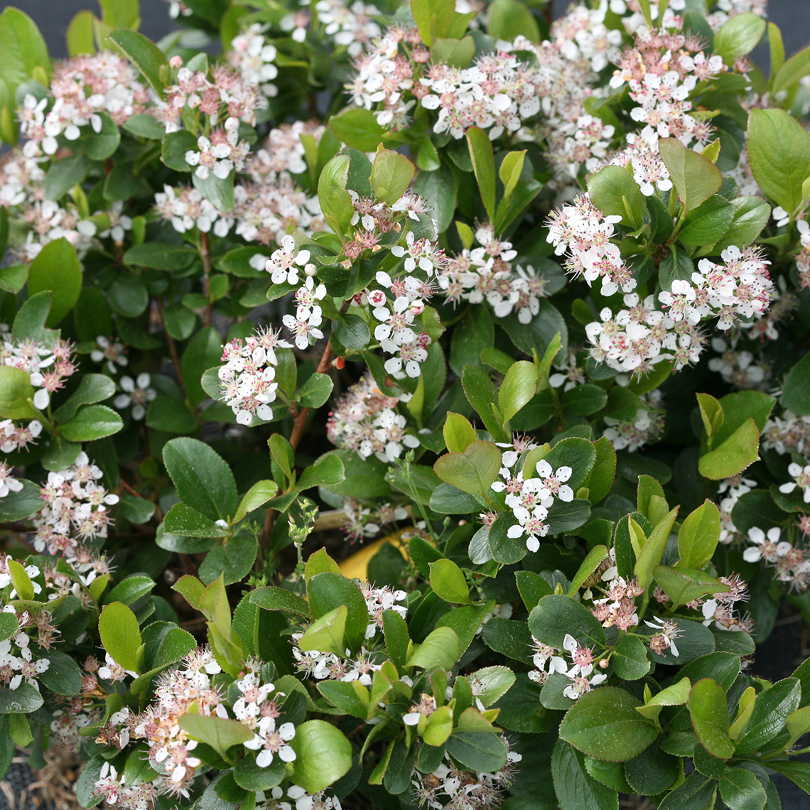
New
Shrub
Beamsville, ON
NATIVE
Aronia
melanocarpa
GROUND HUG®
(Chokeberry)
Photo Courtesy of Spring Meadows

Slide 15
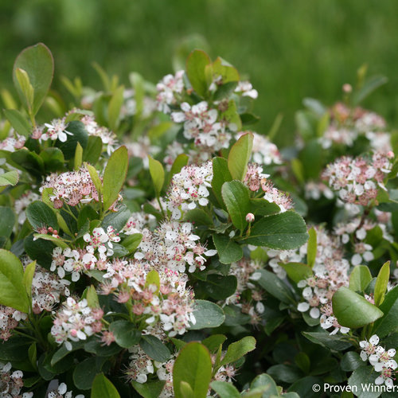
New
Shrub
Beamsville, ON
NATIVE
Aronia
melanocarpa
LOW SCAPE MOUND® ‘UCONNAM165’
(Chokeberry)
Photo Courtesy of Proven Winners

Slide 16
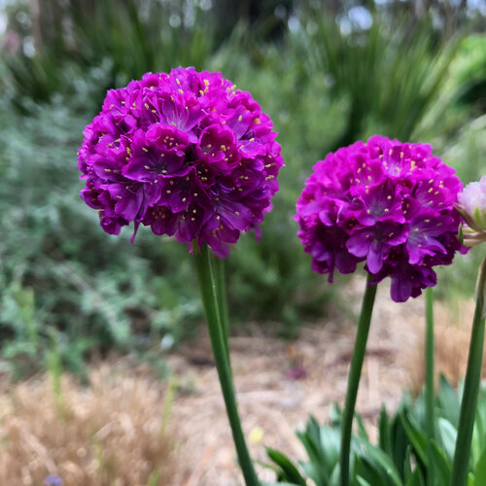
New
Perennial
Beamsville, ON
Armeria
pseudarmeria
DREAMERIA®
VIVID DREAMS
(False Sea Thrift)
Photo Courtesy of Proven Winners

Slide 17
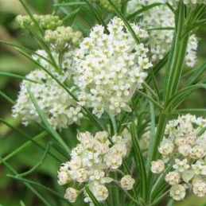
New
Perennial
Beamsville, ON
NATIVE
Asclepias
verticillata
(Whorled Milkweed)

Slide 18
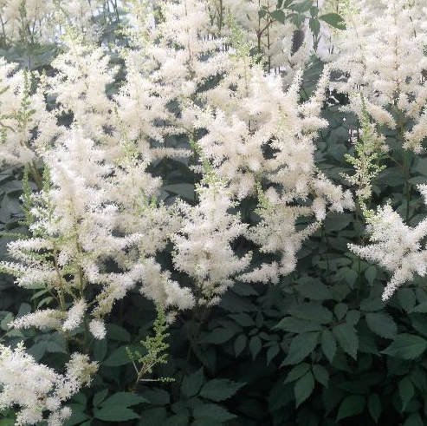
New
Perennial
Beamsville, ON
Astilbe
arendsii
DIAMANT
(False Spirea)
Photo Courtesy of NVK Nurseries

Slide 19
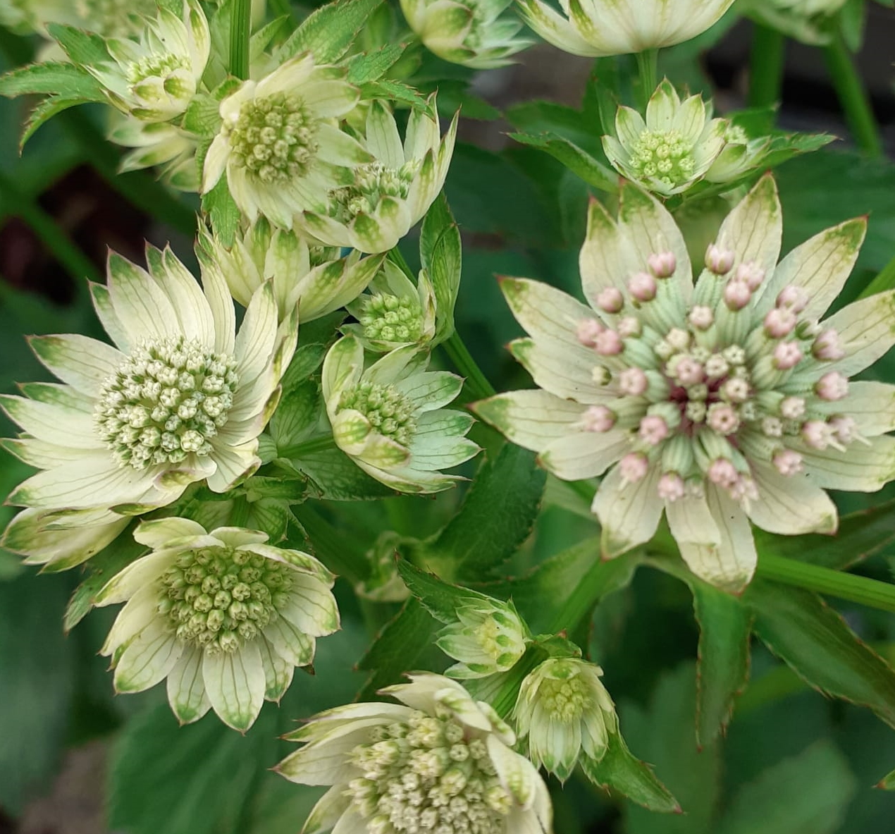
New
Perennial
Beamsville, ON
Astrantia
major
STAR OF BILLION
(Masterwort)

Slide 20
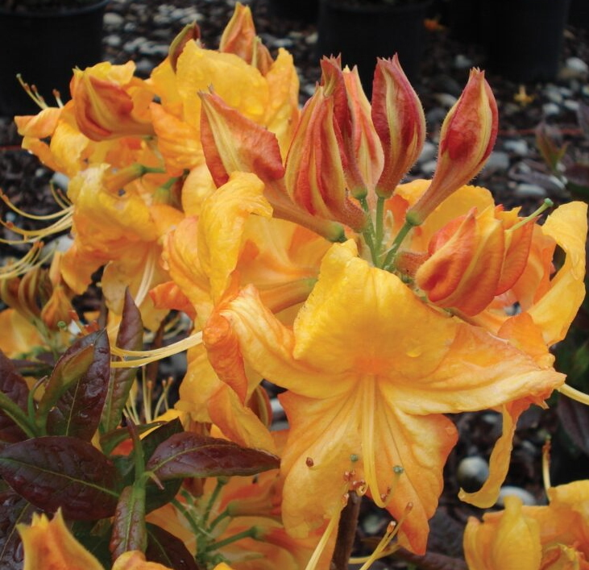
New
Shrub
Beamsville, ON
Azalea
Deciduous
KLONDYKE
(Deciduous Azaleas)
Photo Courtesy of Briggs Nursery

Slide 21
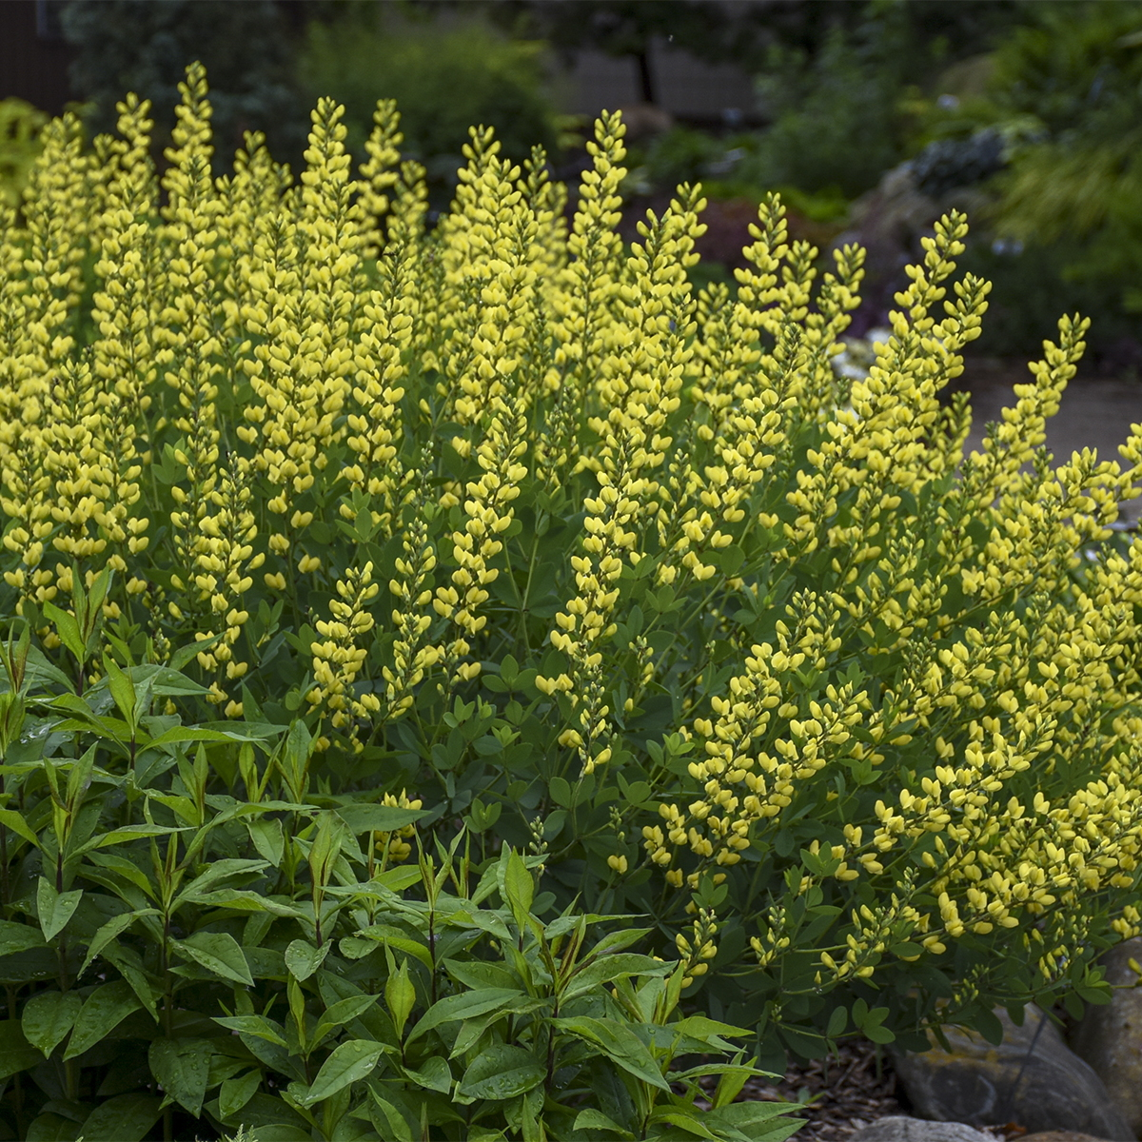
New
Perennial
Beamsville, ON
NATIVAR’
Baptisia
AMERICAN GOLDFINCH
(False Indigo)
Photo courtesy of Walters Gardens, Inc.

Slide 22
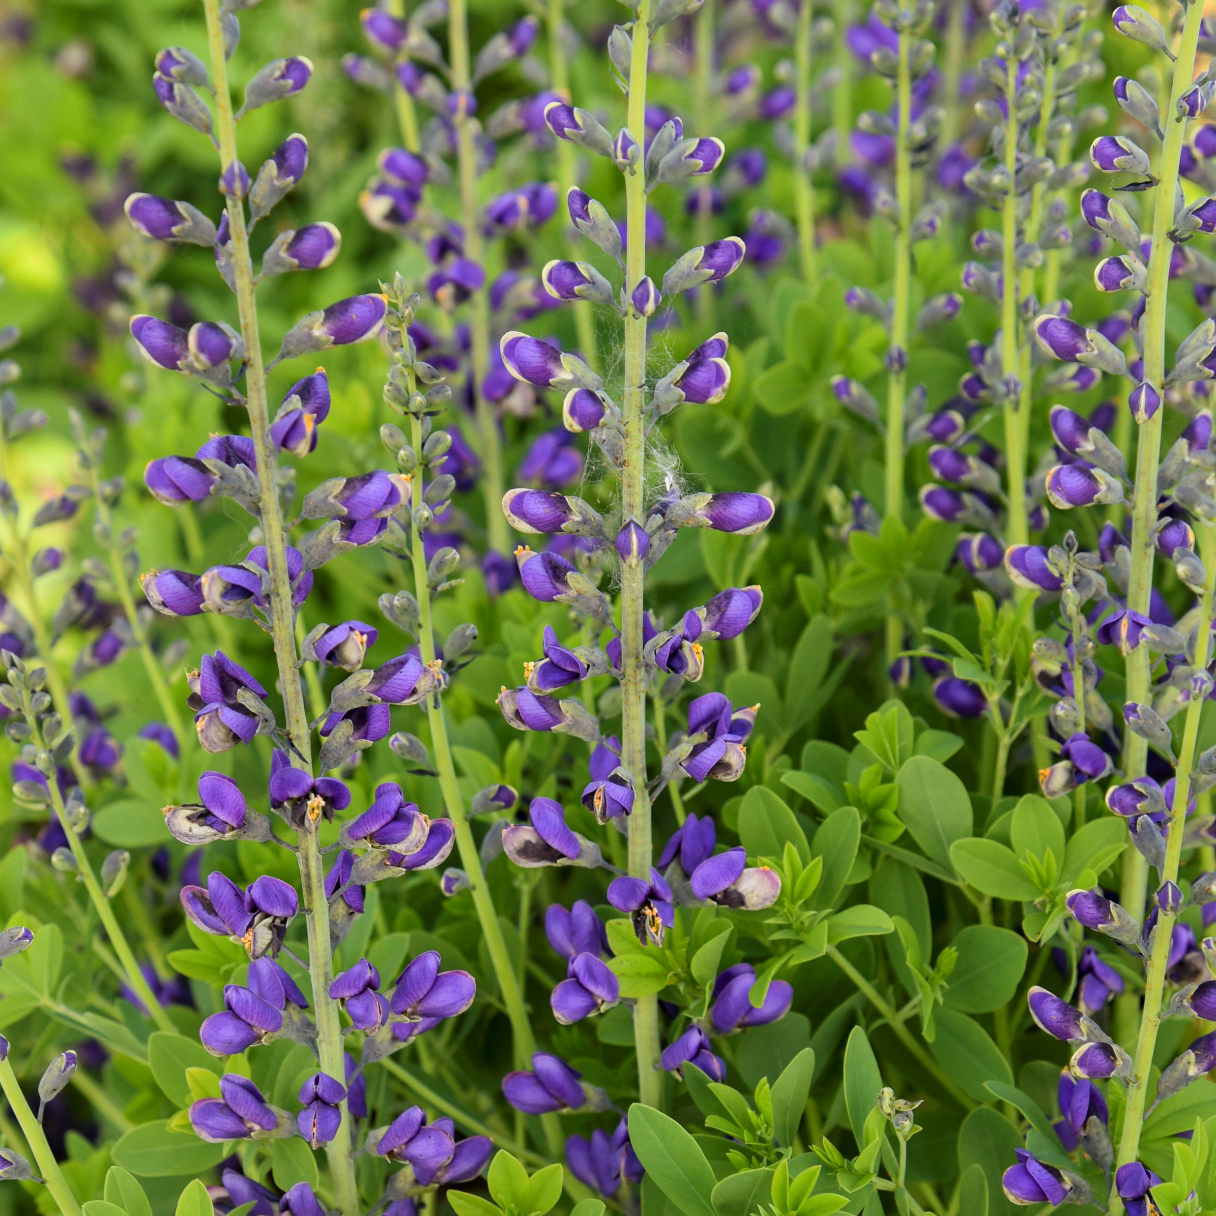
New
Perennial
Beamsville, ON
NATIVAR’
Baptisia
PERIWINKLE POPSICLE
(False Indigo)
Photo courtesy of Walters Gardens, Inc.

Slide 23
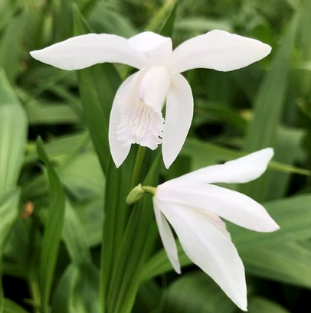
New
Perennial
Beamsville, ON
NATIVE
Bletilla
striata
ALBA
(Chinese Ground Orchid)

Slide 24
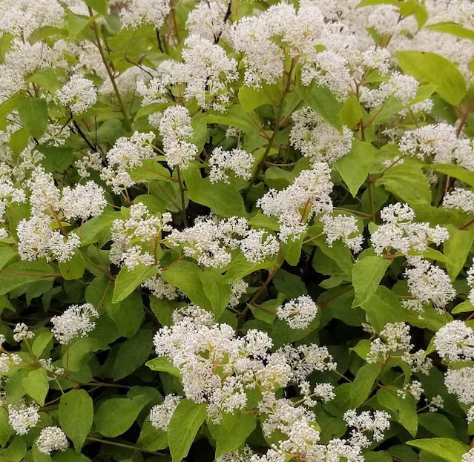
New
Shrub
Beamsville, ON
NATIVE
Ceanothus
americanus
(New Jersey Tea)

Slide 25
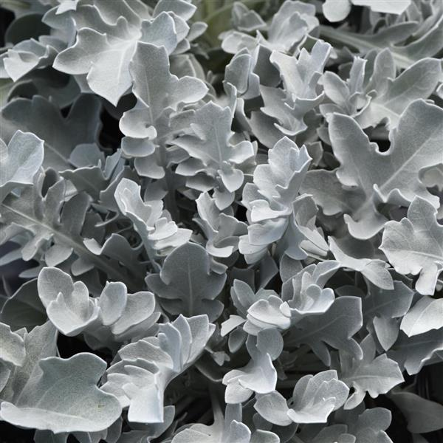
New
Perennial
Beamsville, ON
Centaurea
ragusina
SILVER SWIRL
(Snowflake Dusty Miller)
Photo Courtesy of Ball Horticultural Company

Slide 26
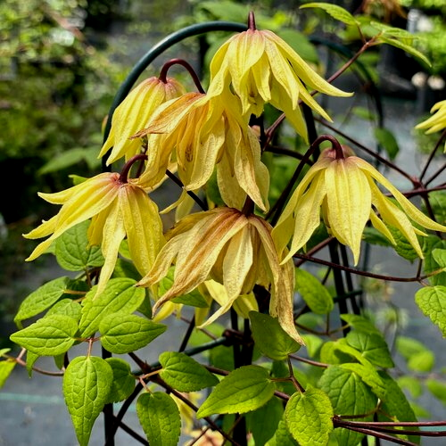
New
Shrub
Beamsville, ON
Clematis
FUNYELLA™
‘Golden Dream’
Photo Courtesy of Proven Winners

Slide 27
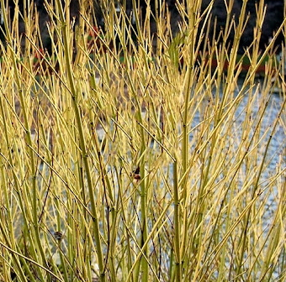
New
Shrub
Beamsville, ON
Cornus
alba
BUD’S YELLOW
(Yellowtwig Dogwood)

Slide 28
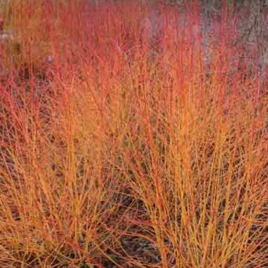
New
Shrub
Beamsville, ON
Cornus
sanguinea
MIDWINTER FIRE
(Bloodtwig Dogwood)

Slide 29
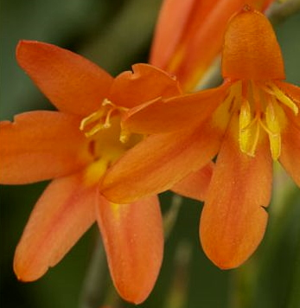
New
Perennial
Beamsville, ON
Crocosmia
ABUNDANT JOY
(Montbretia)

Slide 30
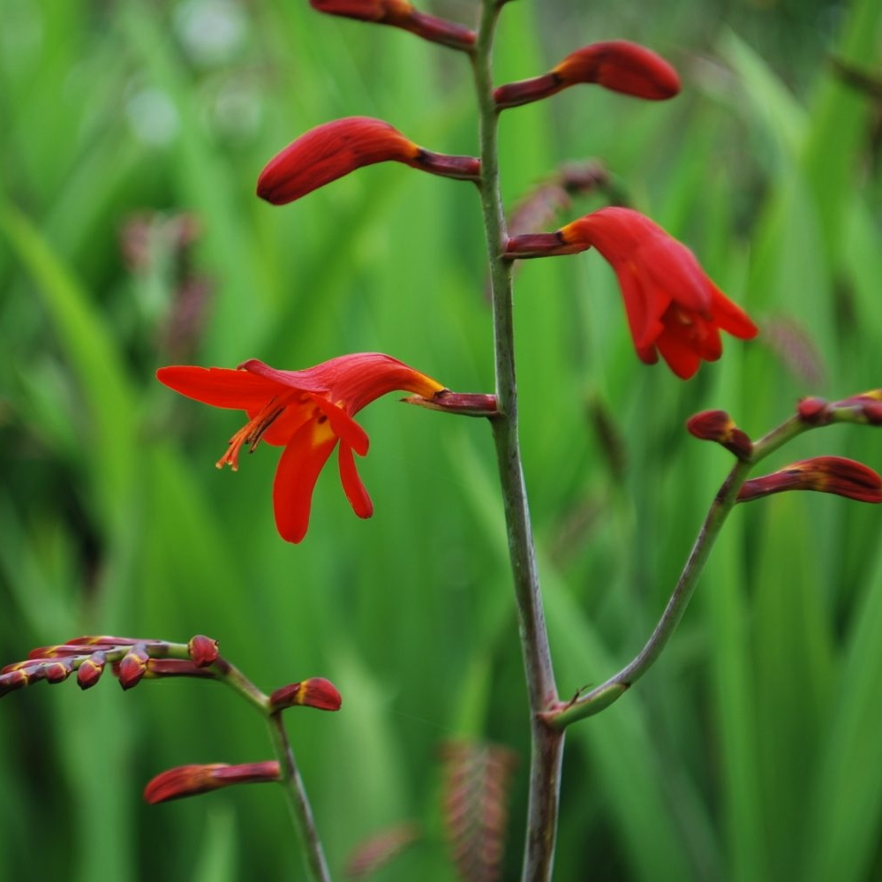
New
Perennial
Beamsville, ON
Crocosmia
EMBERGLOW
(Montbretia)

Slide 31
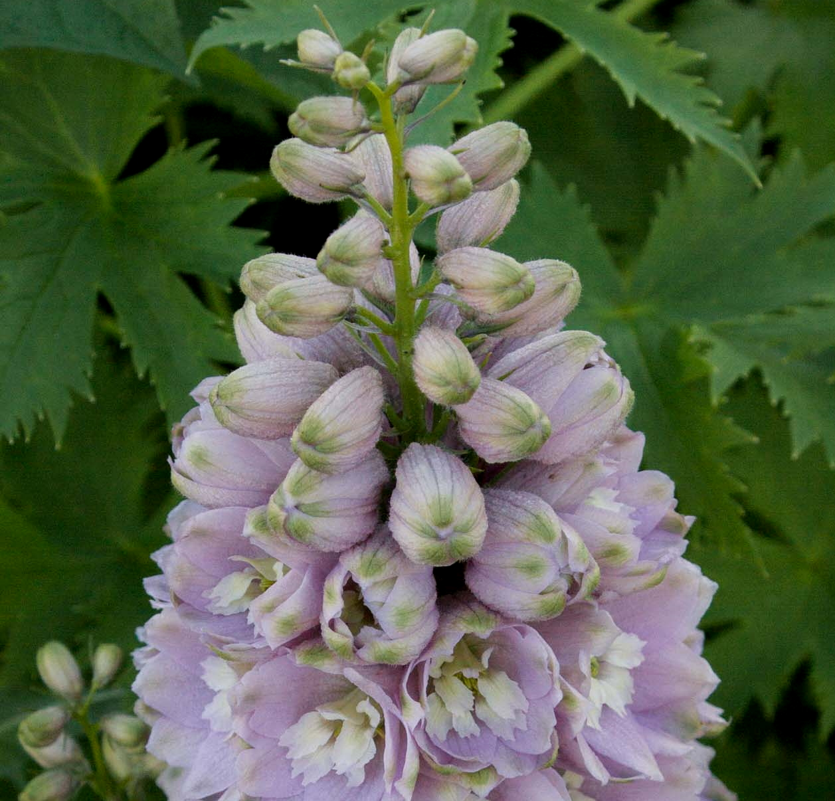
New
Perennial
Beamsville, ON
Delphinium
elatum
MAGIC FOUNTAINS CHERRY BLOSSOM WHITE BEE
(Larkspur)

Slide 32
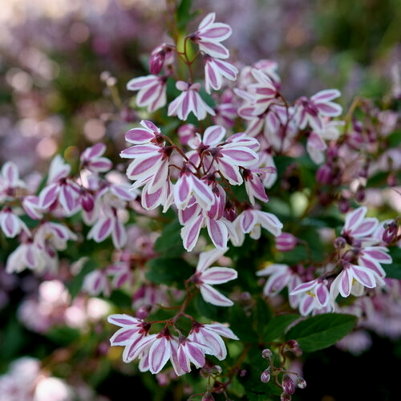
New
Shrub
Beamsville, ON
Deutzia
YUKI KABUKI™ 'NCDX3’
Photo Courtesy of Proven Winners

Slide 33
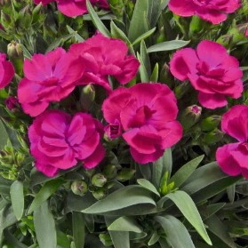
New
Perennials
Beamsville, ON
Dianthus
caryophyllus
PEAMAN VIOLET
(Pinks)

Slide 34
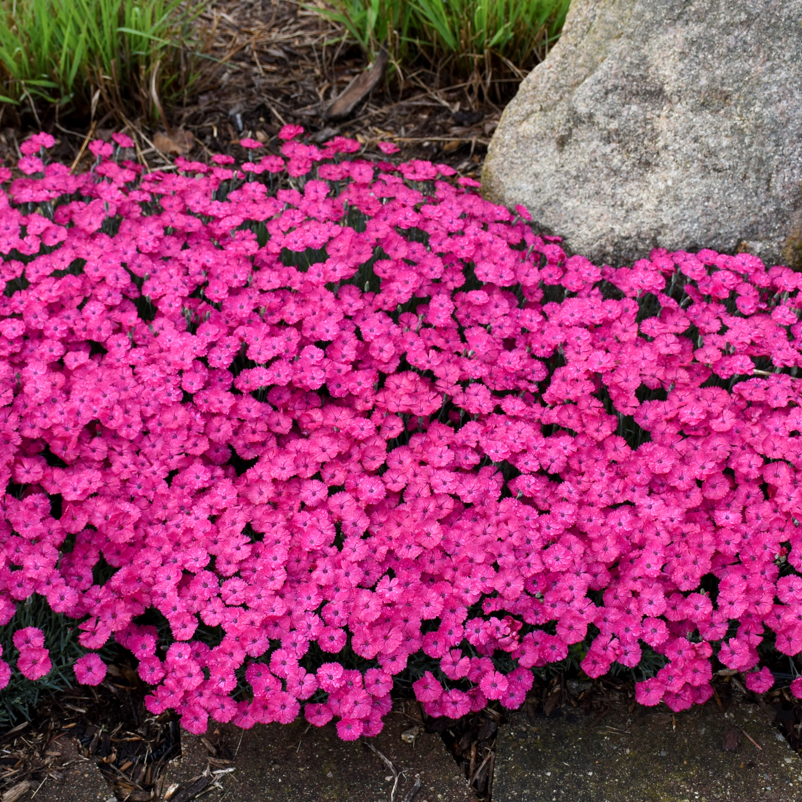
New
Perennial
Beamsville, ON
Dianthus
PAINT THE TOWN MAGENTA
(Pinks)
Photo courtesy of Walters Gardens, Inc.

Slide 35
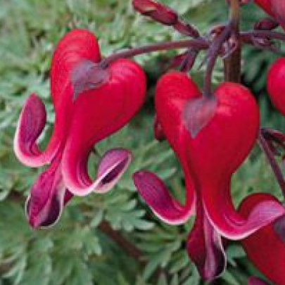
New
Perennial
Beamsville, ON
Dicentra
RED FOUNTAIN
(Fern-Leaf Bleeding Heart)

Slide 36
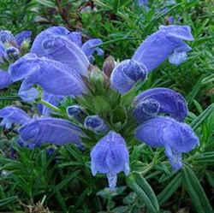
New
Perennial
Beamsville, ON
Dracocephalum
ruyschiana
BLUE DRAGON
(Dragonhead)

Slide 37
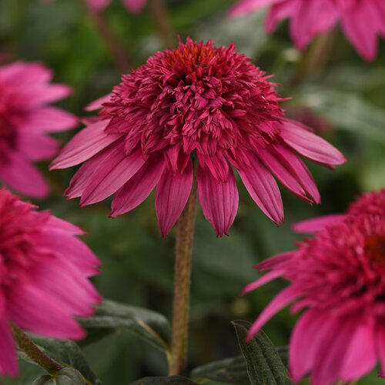
New
Perennial
Beamsville, ON
Echinacea
DOUBLE SCOOP™ WATERMELON DELUXE
(Coneflower)
Photo Courtesy of Proven Winners

Slide 38
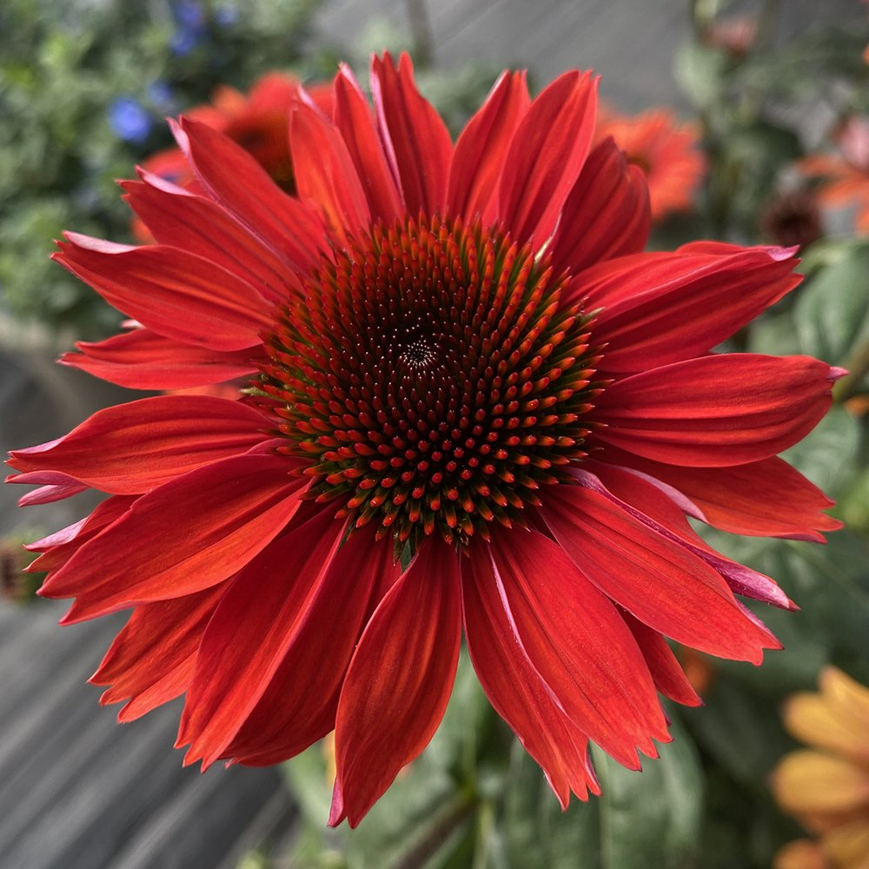
New
Perennial
Beamsville, ON
Echinacea
PANAMA™ RED
(Coneflower)
Photo courtesy of THINK PLANTS

Slide 39
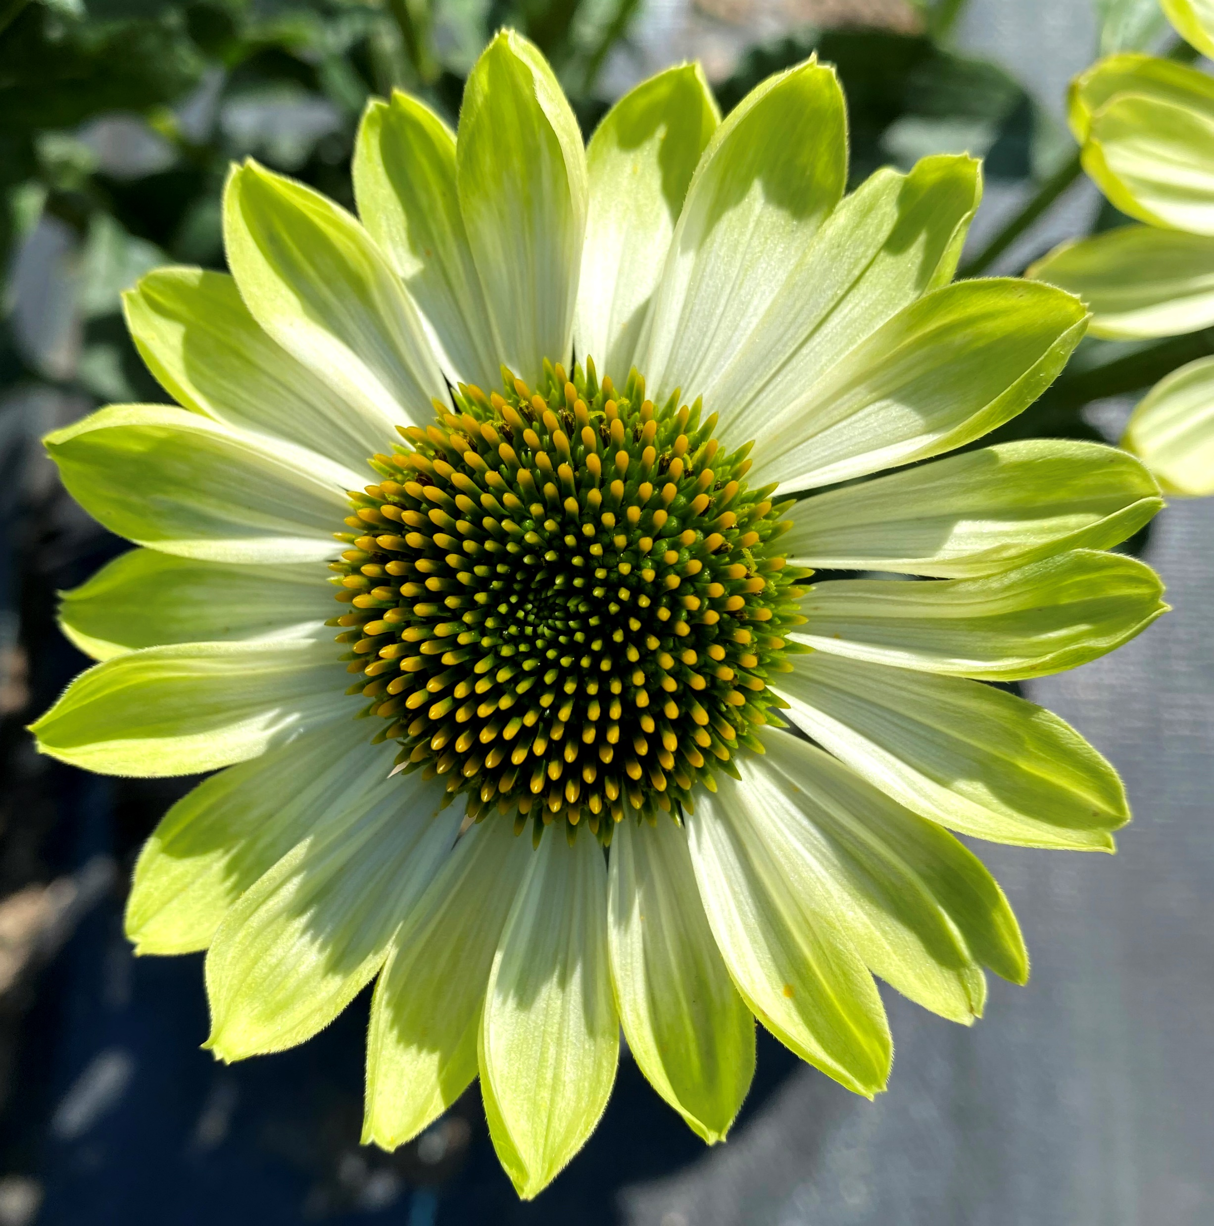
New
Perennial
Beamsville, ON
Echinacea
PRIMA™ LIME
(Coneflower)
Photo courtesy of Terra Nova® Nurseries, Inc.

Slide 40
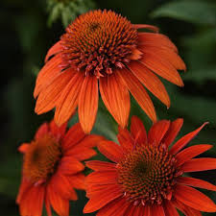
New
Perennial
Beamsville, ON
Echinacea
SOMBRERO™ FIESTA ORANGE
(Coneflower)
Photo Courtesy of Darwin Perennials

Slide 41
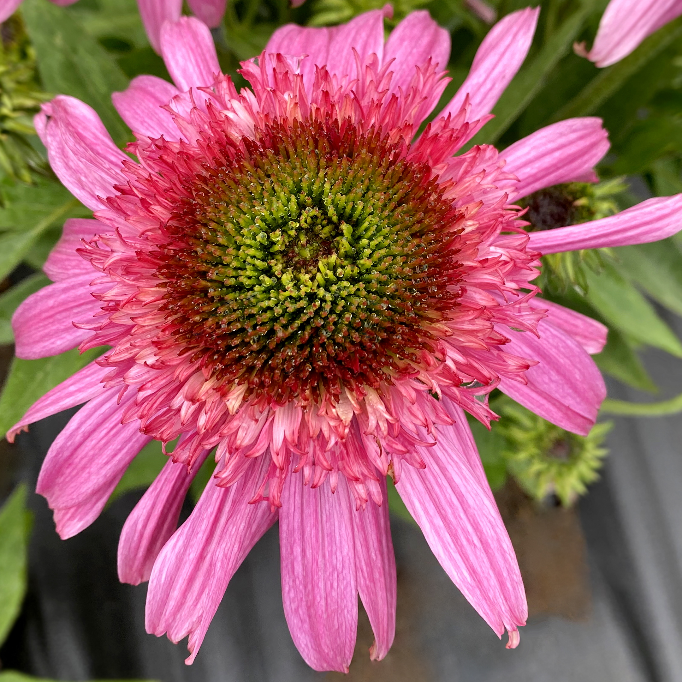
New
Perennial
Beamsville, ON
Echinacea
SUNDIAL™ PINK
(Coneflower)
Photo courtesy of Terra Nova® Nurseries, Inc.

Slide 42
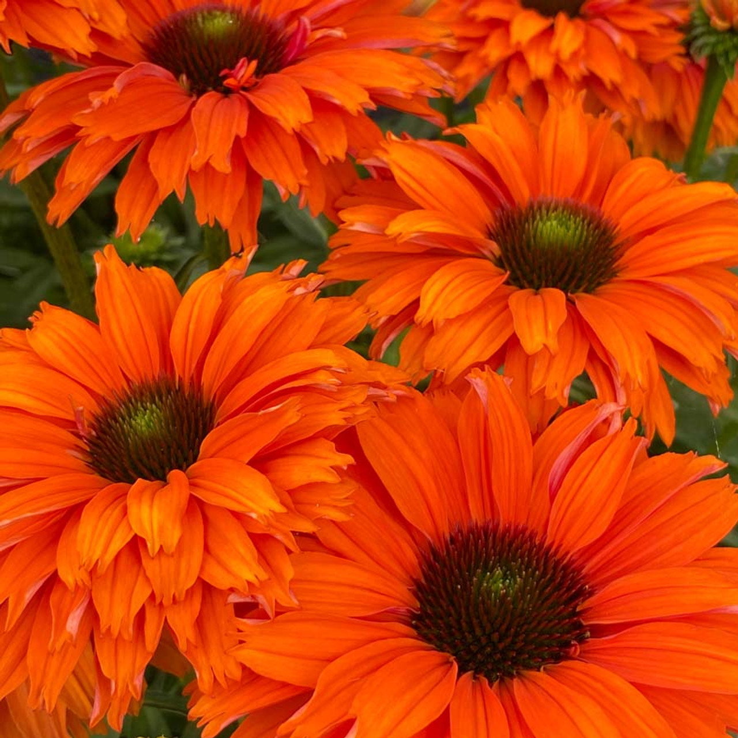
New
Perennial
Beamsville, ON
Echinacea
SUNSEEKERS® MINEOLA
(Coneflower)
Photo courtesy of Emerald Coast Growers

Slide 43
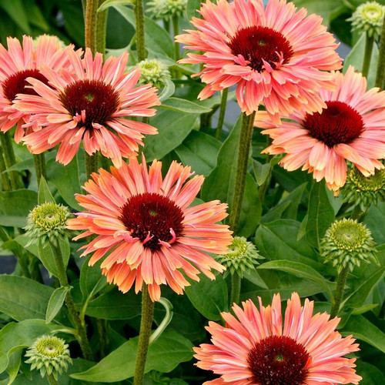
New
Perennial
Beamsville, ON
Echinacea
SUNSEEKERS® RAINBOW
(Coneflower)
Photo courtesy of Emerald Coast Growers

Slide 44
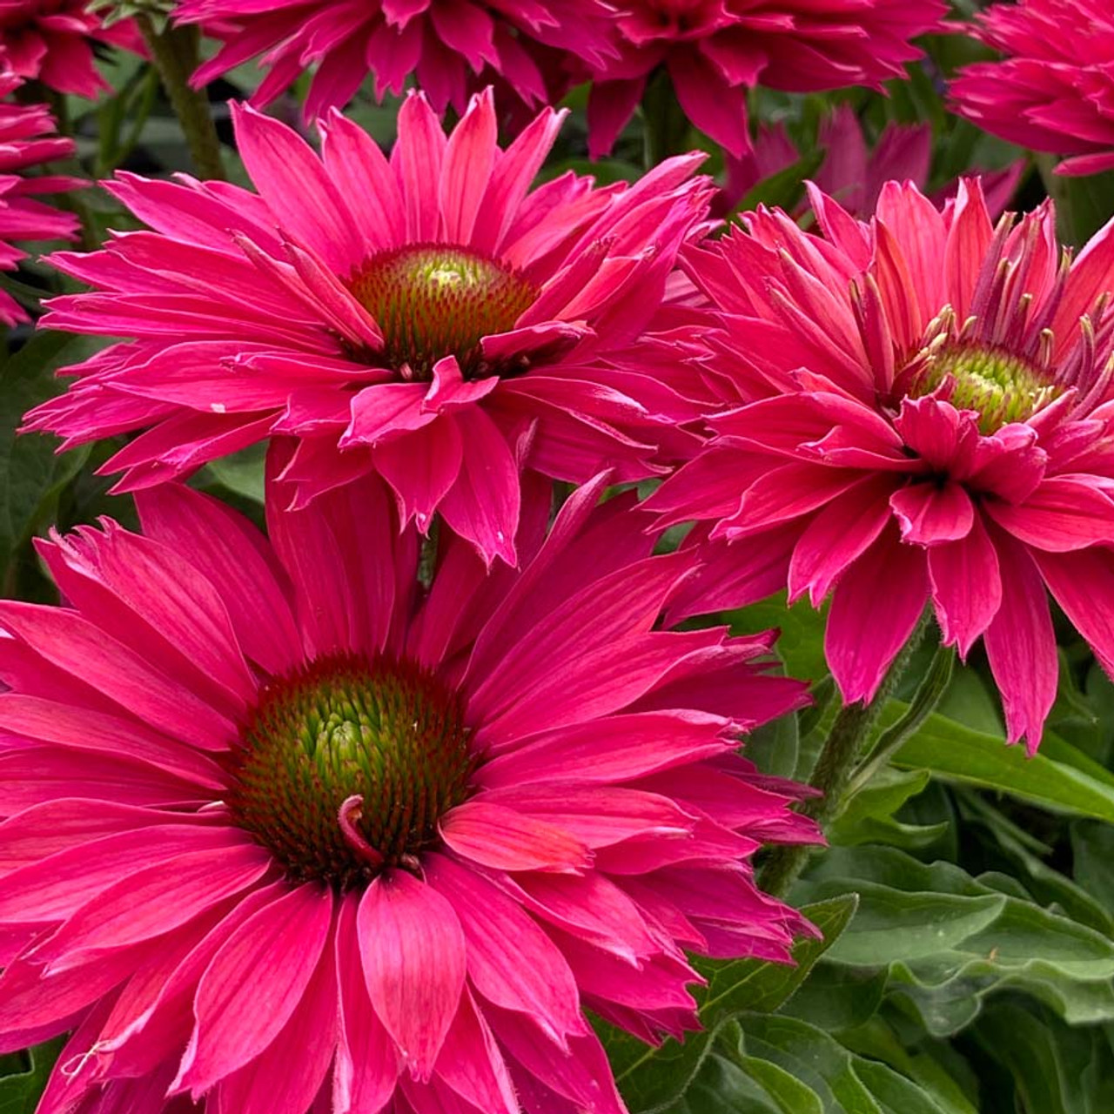
New
Perennial
Beamsville, ON
Echinacea
SUNSEEKERS® SWEET FUCHSIA
(Coneflower)
Photo courtesy of Emerald Coast Growers

Slide 45
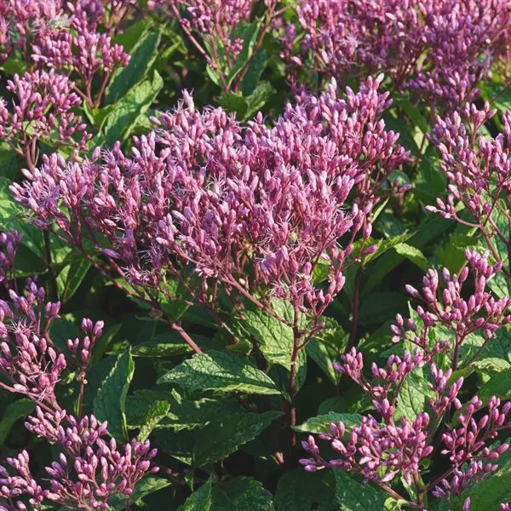
New
Perennial
Beamsville, ON
Eupatorium
purpureum
EUPHORIA™ RUBY
'FLOREUPRE1’
(Joe-Pye Weed)
Photo courtesy of Darwin Perennials

Slide 46
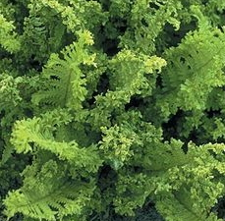
New
Perennial
Beamsville, ON
Fern
Dryopteris filix-mas
CRISPA CRISTATA
(Crested Male Fern)

Slide 47
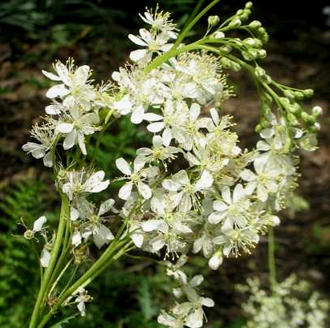
New
Perennial
Beamsville, ON
Filipendula
vulgaris
PLENA
(Meadowsweet)

Slide 48
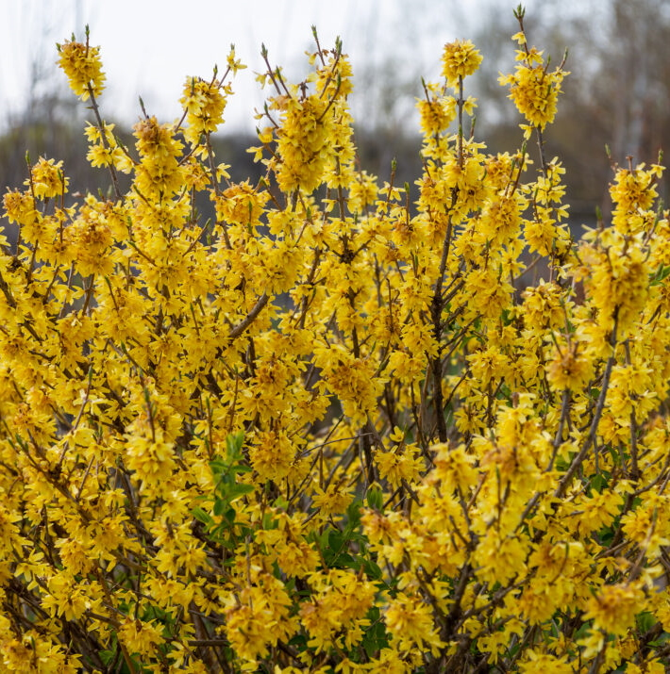

New
Shrub
Beamsville, ON
Forsythia
SPRING FLING®
(Pinks)
Photo Courtesy of First Editions

Slide 49
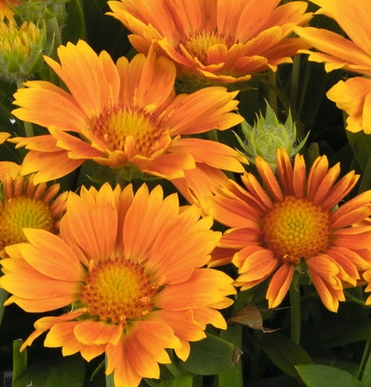
New
Perennial
Beamsville, ON
Gaillardia
aristata
SPINTOP™ MANGO
(Blanket Flower)

Slide 50
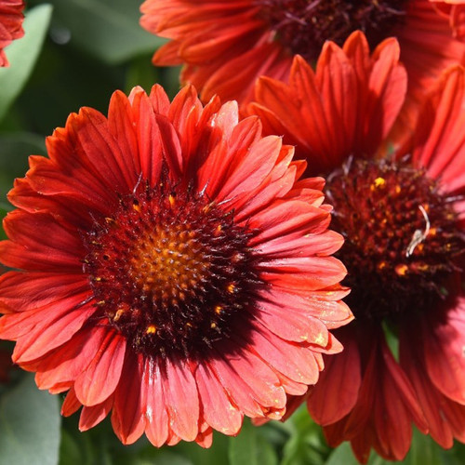
New
Perennial
Beamsville, ON
Gaillardia
aristata
SPINTOP™ MARIACHI RED SKY
(Blanket Flower)
Photo Courtesy of Emeral Coast Growers

Slide 51

New
Perennial
Beamsville, ON
Gaillardia
aristata
SPINTOP™ RED STARBURST
(Blanket Flower)
Photo Courtesy of Emeral Coast Growers

Slide 52

New
Perennial
Beamsville, ON
Gaura
MONARCH PINK
(Wand Flower)

Slide 53

New
Perennial
Beamsville, ON
Gaura
MONARCH WHITE
(Wand Flower)

Slide 54

New
Perennial
Beamsville, ON
Geranium
sanguineum
PINK SUMMER
(Cranesbill)

Slide 55

New
Perennial
Beamsville, ON
Geum
TEMPO™ CORAL
(Avens)
Photo courtesy of Terra Nova® Nurseries, Inc.

Slide 56

New
Perennial
Beamsville, ON
Geum
TEMPO™ ORANGE
(Avens)
Photo courtesy of Terra Nova® Nurseries, Inc.

Slide 57

New
Perennial
Beamsville, ON
Geum
TEMPO™ ROSE
(Avens)
Photo courtesy of Terra Nova® Nurseries, Inc.

Slide 58

New
Perennial
Beamsville, ON
Geum
TEMPO™ YELLOW
(Avens)
Photo courtesy of Terra Nova® Nurseries, Inc.

Slide 59

New
Perennial
Beamsville, ON
NATIVE
Gillenia
trifoliata
(Bowman’s Root)

Slide 60

New
Perennial
Beamsville, ON
Acornus gramineus
OGON
(Golden Variegated Sweet Flag)
Photo Courtesy of Hoffman Nursery, Inc.

Slide 61

New
Perennial
Beamsville, ON
NATIVE
Carex appalachica
(Appalachian Sedge)
Photo Courtesy of Hoffman Nursery, Inc.

Slide 62

New
Perennial
Beamsville, ON
NATIVE
Carex crinita
(Fringed Sedge)
Photo Courtesy of Hoffman Nursery, Inc.

Slide 63

New
Perennial
Beamsville, ON
Molina caerulea
Moorhexe
(Moor Grass)
Photo courtesy of Norview Gardens Ltd.

Slide 64

New
Perennial
Beamsville, ON
Pennisetum alopecuroides
LEMON SQUEEZE
(Fountain Grass)
Photo courtesy of Walter Gardens Inc.

Slide 65

New
Perennial
Beamsville, ON
NATIVE
Schizachyrium
scoparium
HA HA TONKA
(Little Bluestem)
Photo courtesy of Hoffman Nursery Inc.

Slide 66

New
Perennial
Beamsville, ON
Schizachyrium
scoparium
JAZZ
(Little Bluestem)
Photo courtesy of Greenleaf Nursery

Slide 67

New
Perennial
Beamsville, ON
NATIVE
Schizachyrium
scoparium
LITTLE RED FOX
(Little Bluestem)
Photo courtesy of Emerald Coast Growers

Slide 68

New
Perennial
Beamsville, ON
NATIVE
Schizachyrium
scoparium
SANDHILL
(Little Bluestem)
Photo courtesy of Emerald Coast Growers

Slide 69
New
Perennial
Beamsville, ON
NATIVE
Sporobolus heterolepis
GONE WITH THE WIND
(Prairie Dropseed)
Photo courtesy of Walters Gardens, Inc.

Slide 70

New
Annual
Beamsville, ON
Hedychium
TAHITIAN FLAME
(Variegated ginger Lily)
Photo Courtesy of Terra Nova ® Nurseries, Inc.

Slide 71

New
Perennial
Beamsville, ON
Heliopsis
Helianthoides var. scabra
LUNA ROJA
(False Sunflower)
Photo Courtesy of Paridon Horticultural Ltd.

Slide 72

New
Perennial
Beamsville, ON
Helleborus
CALIFORNIA DREAMING
(Honeymoon Series)
(Lenten Rose)
Photo Courtesy of Walters Gardens, Inc.

Slide 73

New
Perennial
Beamsville, ON
Helleborus
CONFETTI CAKE
(Wedding Party Series)
(Lenten Rose)
Photo Courtesy of Walters Gardens, Inc.

Slide 74

New
Perennial
Beamsville, ON
Helleborus
x grandorfensis
HGC® ICE N' ROSES NIGHTINGALE
(Lenten Rose)

Slide 75

New
Perennial
Beamsville, ON
Helleborus
SHOTGUN WEDDING
(Wedding Party Series)
(Lenten Rose)
Photo Courtesy of Walters Gardens, Inc.

Slide 76

New
Perennial
Beamsville, ON
Heuchera
MAHOGANY MONSTER
(Coral Bells)
Photo Courtesy of Walters Gardens, Inc.

Slide 77

New
Perennial
Beamsville, ON
Heuchera
PEACH SMOOTHIE
(Coral Bells)
Photo courtesy of Terra Nova® Nurseries, Inc.

Slide 78

New
Perennial
Beamsville, ON
Hibiscus
COOKIES AND CREAM
(Summerific® Collection)
(Rose Mallow)
Photo Courtesy of Walters Gardens, Inc.

Slide 79

New
Perennial
Beamsville, ON
Hibiscus
MARSHMALLOW MOON
(Rose Mallow)
Photo Courtesy of Walters Gardens, Inc.

Slide 80

New
Shrub
Beamsville, ON
Hibiscus
syriacus
STARBLAST CHIFFON™
(Rose Of Sharon)
Photo Courtesy of Proven Winners

Slide 81

New
Perennial
Beamsville, ON
Hibiscus
WATERMELON RUFFLES
(Rose Mallow)
Photo Courtesy of Walters Gardens, Inc.

Slide 82

New
Perennial
Beamsville, ON
Hosta
GIGANTOSAURUS
(Extra Large)
Photo Courtesy of Walters Gardens, Inc.

Slide 83

New
Perennial
Beamsville, ON
Hosta
LONE STAR
(Large)
Photo Courtesy of Walters Gardens, Inc.

Slide 84

New
Perennial
Beamsville, ON
Hosta
SOUND OF MUSIC
(Extra Large)
Photo Courtesy of Walters Gardens, Inc.

Slide 85

New
Perennial
Beamsville, ON
Hosta
YELLOW POLKA DOT BIKINI
(Small)
Photo Courtesy of Paridon Horticultural Ltd.

Slide 86

New
Shrub
Beamsville, ON
Hydrangea
macrophylla
ECLIPSE® 'Bailmacseven’
(Bigleaf Hydrangea)
Photo courtesy of Bailey® Nurseries

Slide 87


New
Shrub
Beamsville, ON
Hydrangea
macrophylla
SOUL MATE™ 'Hokomasoma’
(Mophead Hydrangea)
Photo courtesy of Bloomin’ Easy®

Slide 88

New
Shrub
Beamsville, ON
Hydrangea
macrophylla
WEE BIT INNOCENT™ ’SMNHMC’
(Bigleaf Hydrangea)
Photo courtesy of Proven Winners

Slide 89

New
Shrub
Beamsville, ON
Hydrangea
paniculata
BOUNCY
(Panicle Hydrangea)

Slide 90

New
Shrub
Beamsville, ON
Hydrangea
paniculata
TINY QUICK FIRE®
(Panicle Hydrangea)
Photo courtesy of Spring Meadow

Slide 91

New
Perennial
Beamsville, ON
Iberis
sempervirens
CANDY SORBET
(Candytuft)

Slide 92

New
Perennial
Beamsville, ON
Iris
gemanica
BLUE TRILL
(Tall Bearded Iris)
Photo Courtesy of Schreiners Irises

Slide 93

New
Perennial
Beamsville, ON
Iris
gemanica
CALIGULA
(Tall Bearded Iris)

Slide 94

New
Perennial
Beamsville, ON
Iris
gemanica
EDGE OF WINTER
(Tall Bearded Iris)

Slide 95

New
Perennial
Beamsville, ON
Iris
gemanica
LEMON POP
(Tall Bearded Iris)

Slide 96

New
Perennial
Beamsville, ON
Iris
gemanica
MIDWEST STAR
(Tall Bearded Iris)

Slide 97

New
Perennial
Beamsville, ON
Iris
gemanica
SNOW MOUND
(Tall Bearded Iris)

Slide 98

New
Perennial
Beamsville, ON
Iris
gemanica
SPRING WINE
(Tall Bearded Iris)

Slide 99

New
Perennial
Beamsville, ON
Isotoma
fluviatilis
(Blue Star Creeper)
NATIVE TO AUSTRALIA

Slide 100

New
Perennial
Beamsville, ON
Kniphofia
GLOWSTICK
(Red-Hot Poker)
Photo Courtesy of Emerald Coast Growers

Slide 101

New
Shrub
Beamsville, ON
Kolkwitzia
amabilis
JOLENE JOLENE
(Beautybush)
Photo Courtesy of Proven Winners

Slide 102

New
Perennial
Beamsville, ON
Lavandula
angustifolia
LA DIVA ETERNAL FRAGRANCE
(English Lavender)

Slide 103

New
Shrub
Beamsville, ON
Lonicera
nitida
THUNDERBOLT®
‘GOLDEN GLOW’
(Box Honeysuckle)
Photo Courtesy of Bloomin’ Easy

Slide 104

New
Perennial
Beamsville, ON
Lynchnis
chalcedonica
(Maltese Cross)
NATIVE TO EURASIA

Slide 105

New
Perennial
Beamsville, ON
NATIVE
Maianthemum
racemosum
(False Soloman’s Seal)

Slide 106

New
Perennial
Beamsville, ON
Malva
sylvestris
ZEBRINA
(Hollyhock Mallow, Zebra Mallow)
Photo Courtesy of Walters Gardens, Inc.

Slide 107

New
Perennial
Beamsville, ON
Mangave
MISSION TO MARS
(Mangave)
Photo Courtesy of Walters Gardens, Inc.

Slide 108

New
Perennial
Beamsville, ON
Nepeta
KITTEN AROUND
(Catmint)
Photo Courtesy of Walters Gardens, Inc.

Slide 109

New
Perennial
Beamsville, ON
NATIVE
Oenothera
biennis
(Common Evening Primrose)

Slide 110

New
Perennial
Beamsville, ON
Oredenia
FUSION OF FIRE
(Oredenia)
Photo courtesy of Walters Gardens, Inc.

Slide 111

New
Perennial
Beamsville, ON
Papaver
nudicaula
CHAMPAGNE BUBBLLES ORANGE
(Iceland Poppy)
Photo Courtesy of Paridon Horticultural Ltd.

Slide 112

New
Perennial
Beamsville, ON
Papaver
nudicaula
CHAMPAGNE BUBBLLES SCARLET
(Iceland Poppy)
Photo Courtesy of Paridon Horticultural Ltd.

Slide 113

New
Perennial
Beamsville, ON
Parthenocissus
quinquefolia
(Virginia Creeper)

Slide 114

New
Perennial
Beamsville, ON
Penstemon
barbatus
ROCK CANDY® LIGHT PINK
‘NovapenLig’
(Beard Tongue)
Photo Courtesy of Ball horticultural Company

Slide 115

New
Perennial
Beamsville, ON
Penstemon
barbatus
ROCK CANDY® PURPLE
‘Balrocurp’
(Beard Tongue)
Photo Courtesy of Proven Winners

Slide 116

New
Perennial
Beamsville, ON
Perovskia
atriplicifolia
CRAZY BLUE
(Russian Sage)
Photo Courtesy of Ball horticultural Company

Slide 117

New
Shrub
Beamsville, ON
Philadelphus
coronarius
ILLUMINATI SPICE™ 'SMNPSDW’
(Mock Orange)
Photo Courtesy of Proven Winners

Slide 118

New
Perennial
Beamsville, ON
Phlox
Glaberrima ssp. Interior
(Smooth Phlox)
NATIVE TO MIDWESTERN
& SOUTHEASTERN US

Slide 119

New
Perennial
Beamsville, ON
Phlox
subulata
SCARLET FLAME
(Moss Phlox)
Photo Courtesy of Paridon Horticultural Ltd.

Slide 120

New
Shrub
Beamsville, ON
Physocarpus
opulifolius
CALICO KITTY™
‘AuntieB’
(Ninebark)
Photo courtesy of Bloomin' Easy®

Slide 121

New
Shrub
Beamsville, ON
Physocarpus
opulifolius
COUGAR CUB™
‘SueCKat’
(Ninebark)
Photo courtesy of Bloomin' Easy®

Slide 122

New
Shrub
Beamsville, ON
Physocarpus
opulifolius
SAVANNAH SUNSET™
‘LP1’
(Ninebark)
Photo courtesy of Bloomin' Easy®

Slide 123

New
Perennial
Beamsville, ON
Platycodon
grandiflorus
POP STAR™
PINK
(Balloon Flower)
Photo Courtesy of Paridon Horticultural Ltd.

Slide 124

New
Perennial
Beamsville, ON
NATIVE
Podophyllum
peltatum
(May Apple)

Slide 125

New
Shrub
Beamsville, ON
Potentilla
fruticosa
BELLA SOL®
‘Hachdon’
(Bush Cinquefoil)
Photo courtesy of Bloomin' Easy®

Slide 126

New
Shrub
Beamsville, ON
Potentilla
nepalensis
GIBSON’S SCARLET
(Cinquefoil)

Slide 127

New
Broadleaf Evergreen
Beamsville, ON
Rhododendron
HOLDEN’S PEACH™
^{‘HoldenRhodo213’}
(Elepidote)
Photo Courtesy of Briggs Nursery

Slide 128

New
Broadleaf Evergreen
Beamsville, ON
Hydrangea
paniculata
BLOOMBUX® BLUSH
^{‘Microhirs3’}
(Bloombux Blush Rhododendron)
Photo courtesy of Bloomin' Easy®

Slide 129

New
Broadleaf Evergreen
Beamsville, ON
Hydrangea
paniculata
BLOOMBUX® MAGENTA
^{‘Microhirs9’}
(Bloombux Magenta Rhododendron)

Slide 130

New
Broadleaf Evergreen
Beamsville, ON
Rhododendron
YAKU PRINCE
(Yakushimanum Hybrid)

Slide 131

New
Perennial
Beamsville, ON
Roscoea
purpurea
(Roscoe’s Lily)
NATIVE TO HIMALAYAS

Slide 132

New
Small Fruit
Edibles
Beamsville, ON
Rubus
GLENCOE
(Purple thornless Raspberry)

Slide 133

New
Perennial
Beamsville, ON
Rudbeckia
fulgida
GOLDBLITZ
(Black-Eyed Susan)
Photo Courtesy of Emerald Coast Growers

Slide 134

New
Perennial
Beamsville, ON
Salvia
nemorosa
DARK MATTER™
(Garden Sage)

Slide 135

New
Shrub
Beamsville, ON
Sambucus
canadensis
(American Black Elderberry)
Photo Courtesy of NVK Nurseries

Slide 136

New
Perennial
Beamsville, ON
Sanguinaria
canadensis
(Bloodroot)

Slide 137

New
Perennial
Beamsville, ON
Scabiosa
columbaria
NOVA®
DEW DROPS
(Variegated Pincushion)
Photo courtesy of Terra Nova® Nurseries, Inc.

Slide 138

New
Perennial
Beamsville, ON
Scutellaria
incarna
(Downy/Hoary Skullcap)
Photo Courtesy of NVK Nurseries

Slide 139

New
Perennial
Beamsville, ON
Sempervivum
STEEL APPEAL
(Hens and Chicks)

Slide 140

New
Perennial
Beamsville, ON
NATIVE
Sisyrinchium
nashii
SUWANNEE
(Blue-eyed Grass)

Slide 141

New
Perennial
Beamsville, ON
NATIVE
Symphyotrichum
shortii
(Short’s Aster)

Slide 142

New
Perennial
Beamsville, ON
Symphytum
grandiflorum
(Comfrey)

Slide 143

New
Perennial
Beamsville, ON
NATIVE
Thalictrum
dioicum
(Early Meadow Rue)

Slide 144

New
Shrub
Beamsville, ON
NATIVE
Thuja
occidentalis
NORTH POLE®
‘Art Boe’
(American Arborvitae)
Photo Courtesy of Spring Meadow

Slide 145

New
Shrub
Beamsville, ON
NATIVE
Thuja
occidentalis
FULL SPEED A HEDGE®
THIN MAN®
‘SMTOTM’
(Arborvitae)
Photo Courtesy of Spring Meadow

Slide 146

New
Perennial
Beamsville, ON
Tricyrtis
hirta
(Japanese Toad Lily)
Photo courtesy of Van Noort Bulb Co. Ltd.

Slide 147

New
Perennial
Beamsville, ON
NATIVE
Trillium
grandiflorum
(White Trillium)

Slide 148

New
Perennial
Beamsville, ON
Viola
cornuta
HALO VIOLET
(Violet)
Photo courtesy of Darwin Perennials

Slide 149
New
Perennial
Beamsville, ON
Viola
walteri
SILVER GEM
(Prostrate Blue Violet)
Photo courtesy of North Creek Nurseries

Slide 150

New
Perennial
Beamsville, ON
Veronica
longifolia
SKYWARD™ PINK
(Speedwell)
Photo courtesy of Darwin Perennials

Slide 151

New
Shrub
Beamsville, ON
Weigela
florida
TOWERS OF FLOWERS® CHERRY
‘WG16-04’
(Weigela)

Slide 152

New
Shrub
Beamsville, ON
Xanthorhiza
Simplicissima
(Yellow Root)

