Slide 1
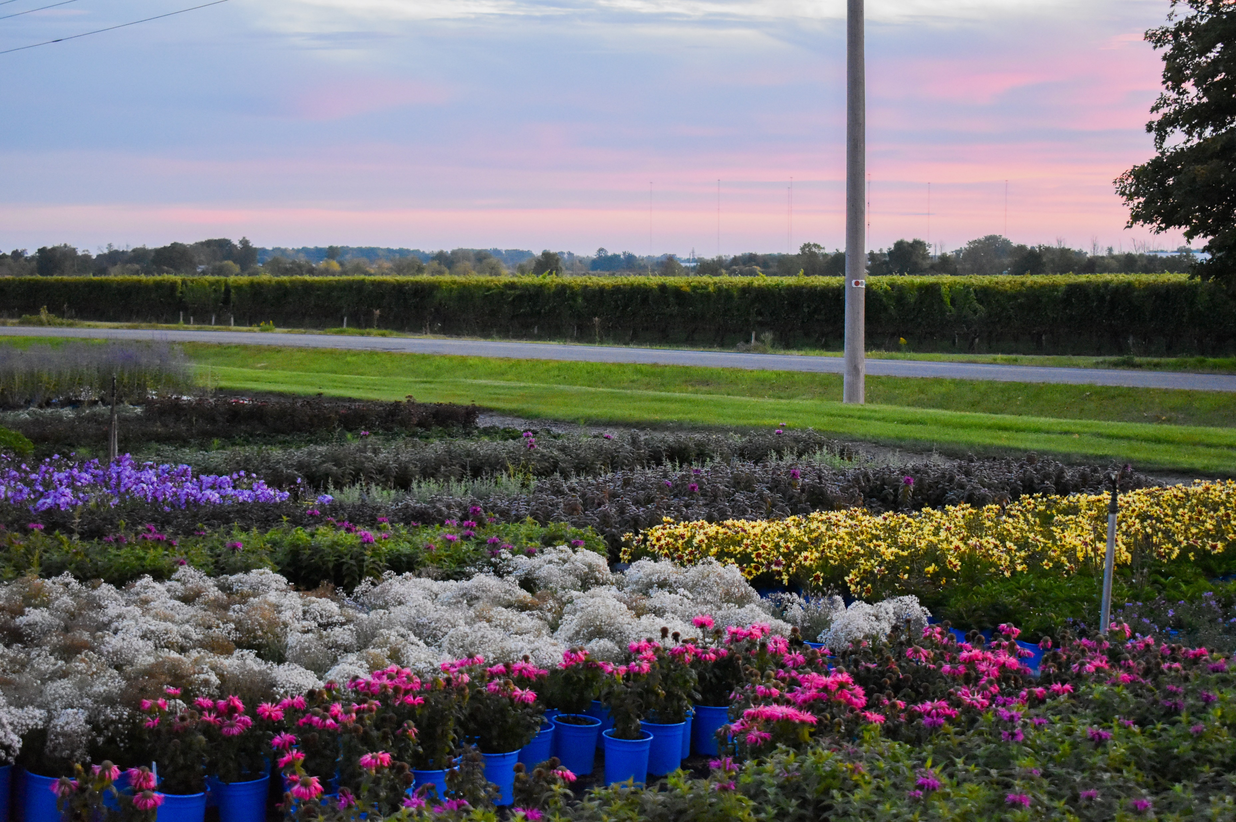
Blue Sky Nursery L I M I T E D
NEW Plants 2025

Slide 2
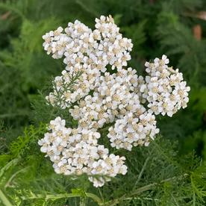
New Perennial
Beamsville, ON
NATIVE
Achillea
millefolium (White Yarrow)
Photo Courtesy of North Creek Nurseries

Slide 3
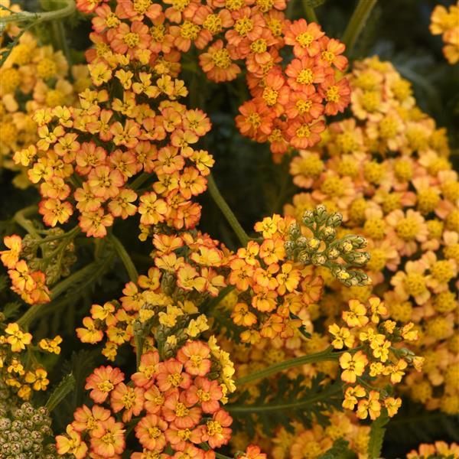
New Perennial
Beamsville, ON
Achillea
millefolium MILLY ROCK™ YELLOW TERRACOTTA
(Yarrow)
Photo Courtesy of Ball Horticultural Company

Slide 4
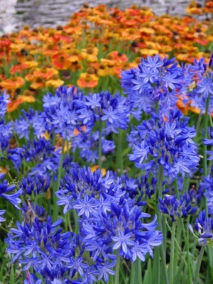
New Perennial
Beamsville, ON
Agapanthus NORTHERN STAR (Lily of the Nile)
Photo Courtesy of Paridon Horticultural Ltd.

Slide 5
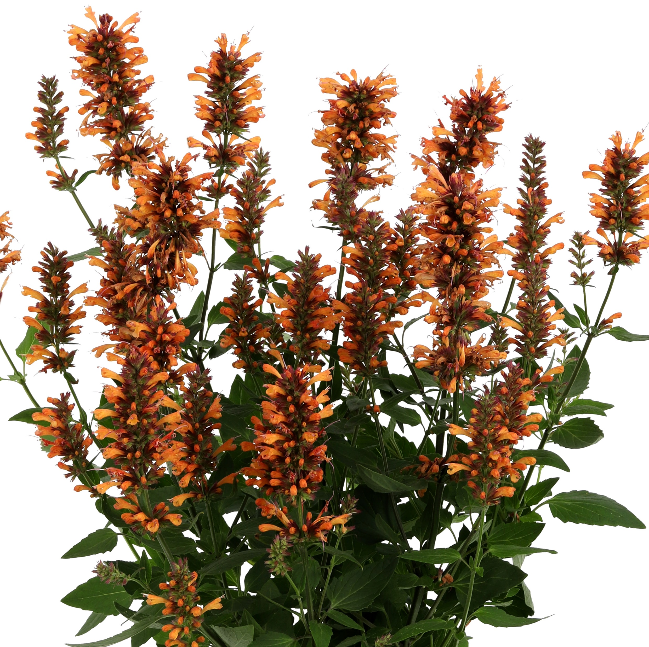
New Perennial
Beamsville, ON
Agastache HONEYSTICKS EMBER (Giant Hyssop)
Photo Courtesy of Ball Horticultural Company

Slide 6
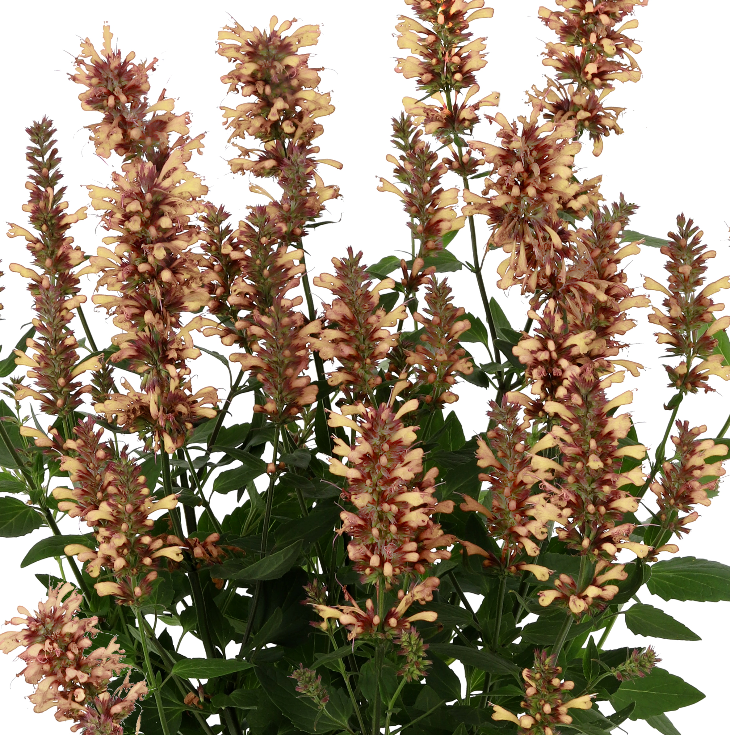
New Perennial
Beamsville, ON
Agastache HONEYSTICKS SANDSTONE (Giant Hyssop)
Photo Courtesy of Ball Horticultural Company

Slide 7
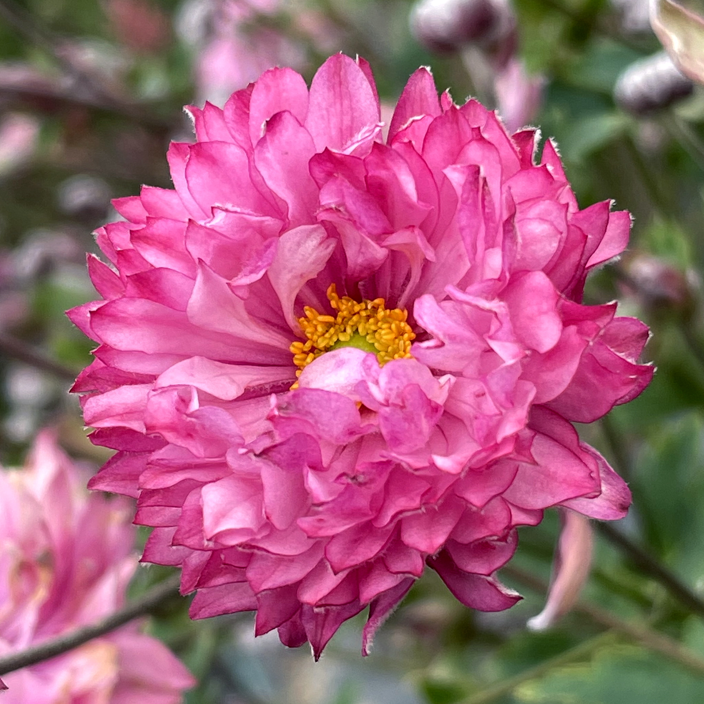
New Perennial
Beamsville, ON
Anemone
simplex PUFF® PINK
(Wind Flower)
Photo Courtesy of Terra Nova® Nurseries, Inc.

Slide 8
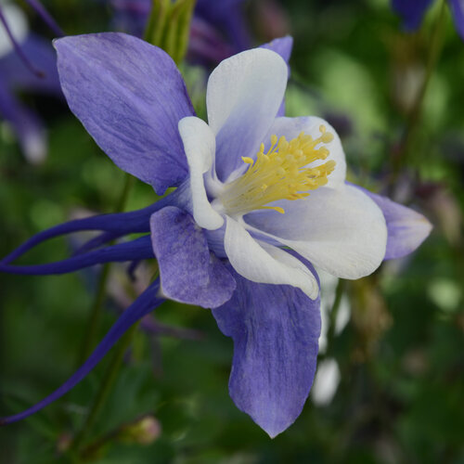
New Perennial
Beamsville, ON
Aquilegia EARLYBIRD™
BLUE WHITE (Columbine)
Photo Courtesy of Proven Winners

Slide 9
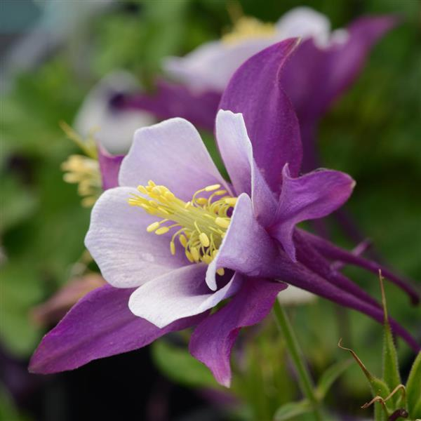
New Perennial
Beamsville, ON
Aquilegia EARLYBIRD™
PURPLE WHITE (Columbine)
Photo Courtesy of Ball Horticultural Company

Slide 10
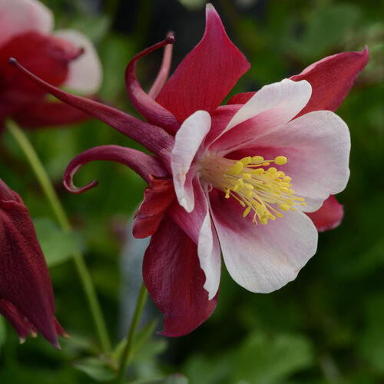
New Perennial
Beamsville, ON
Aquilegia EARLYBIRD™
RED WHITE (Columbine)
Photo Courtesy of Proven Winners

Slide 11
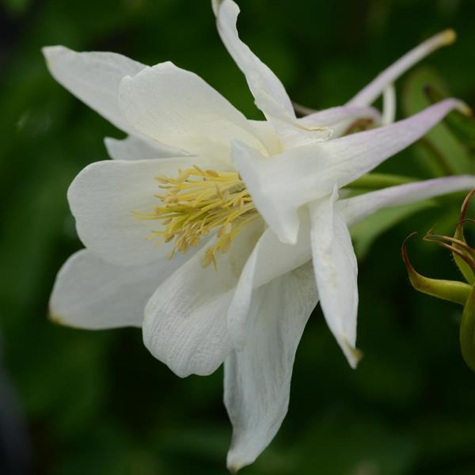
New Perennial
Beamsville, ON
Aquilegia EARLYBIRD™
WHITE (Columbine)
Photo Courtesy of Ball Horticultural Company

Slide 12
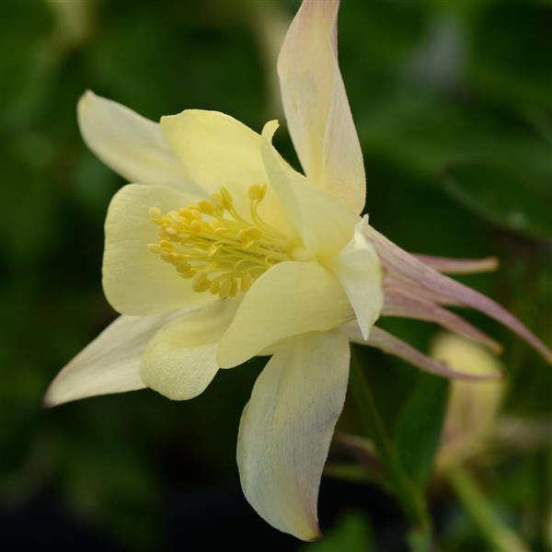
New Perennial
Beamsville, ON
Aquilegia EARLYBIRD™
YELLOW (Columbine)
Photo Courtesy of Ball Horticultural Company

Slide 13
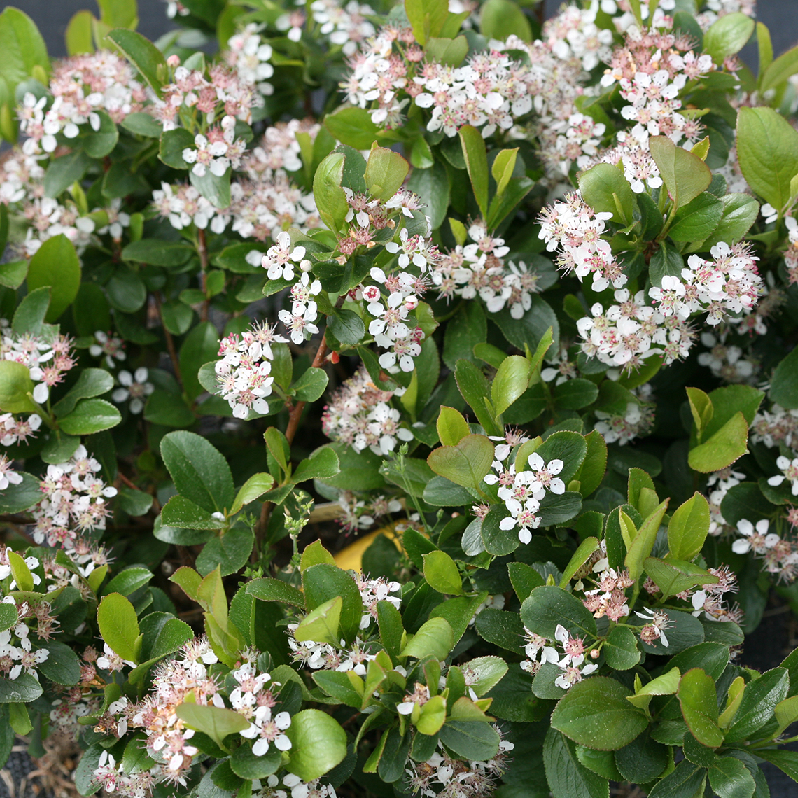
New Shrub
Beamsville, ON
NATIVE
Aronia
melanocarpa GROUND HUG® (Chokeberry)
Photo Courtesy of Spring Meadows

Slide 14
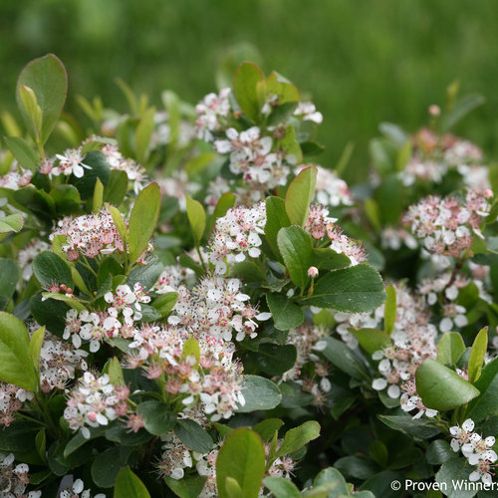
New Shrub
Beamsville, ON
NATIVE
Aronia
melanocarpa LOW SCAPE MOUND® ‘UCONNAM165’ (Chokeberry)
Photo Courtesy of Proven Winners

Slide 15
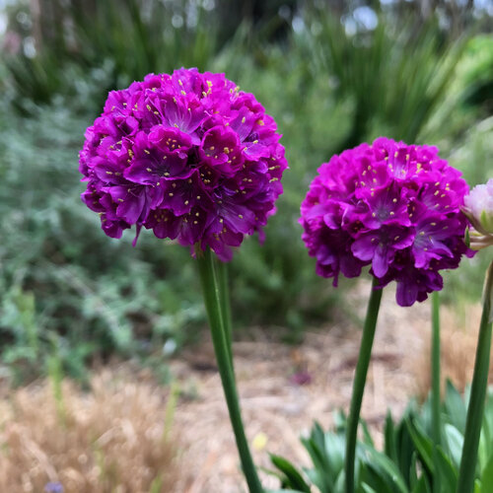
New Perennial
Beamsville, ON
Armeria pseudarmeria
DREAMERIA®
VIVID DREAMS (False Sea Thrift)
Photo Courtesy of Proven Winners

Slide 16
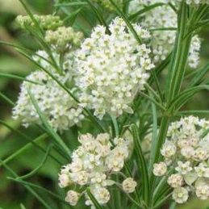
New Perennial
Beamsville, ON
NATIVE
Asclepias
verticillata
(Whorled Milkweed)

Slide 17
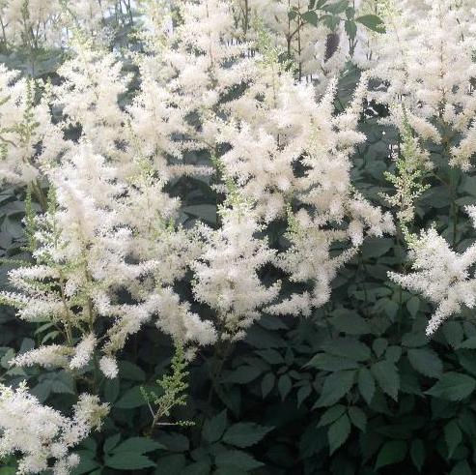
New Perennial
Beamsville, ON
Astilbe
arendsii DIAMANT
(False Spirea)
Photo Courtesy of NVK Nurseries

Slide 18
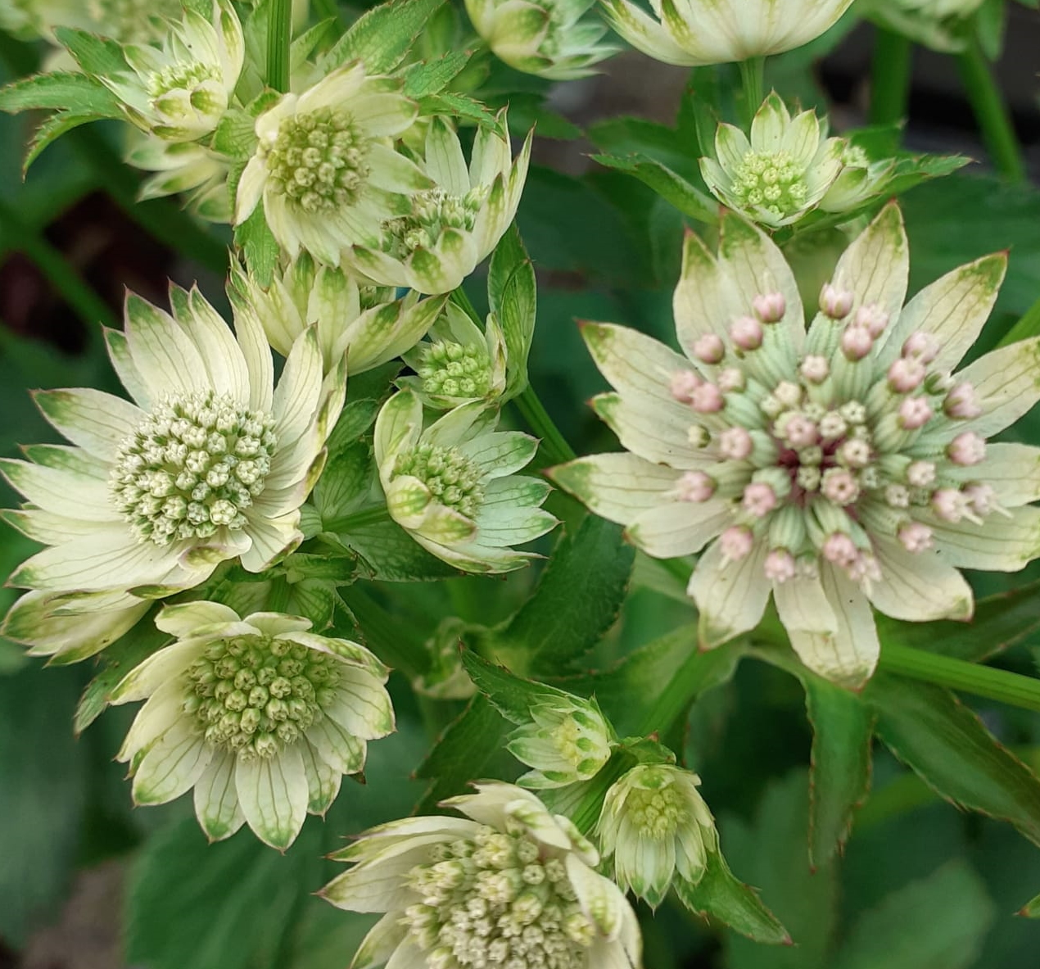
New Perennial
Beamsville, ON
Astrantia major STAR OF BILLION
(Masterwort)

Slide 19
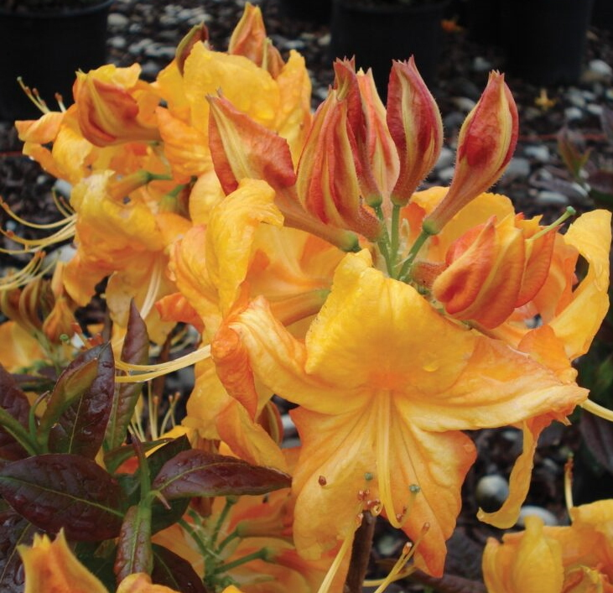
New Shrub
Beamsville, ON
Azalea Deciduous KLONDYKE
(Deciduous Azalea)
Photo Courtesy of Briggs Nursery

Slide 20
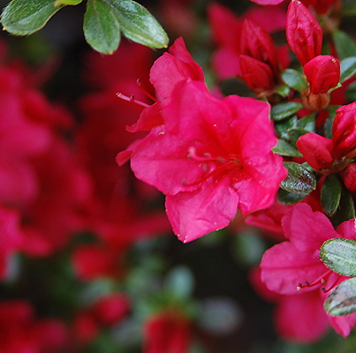
New Shrub
Beamsville, ON
^{COMING SOON}
Azalea Evergreen HINO CRIMSON
(Evergreen Azalea)

Slide 21
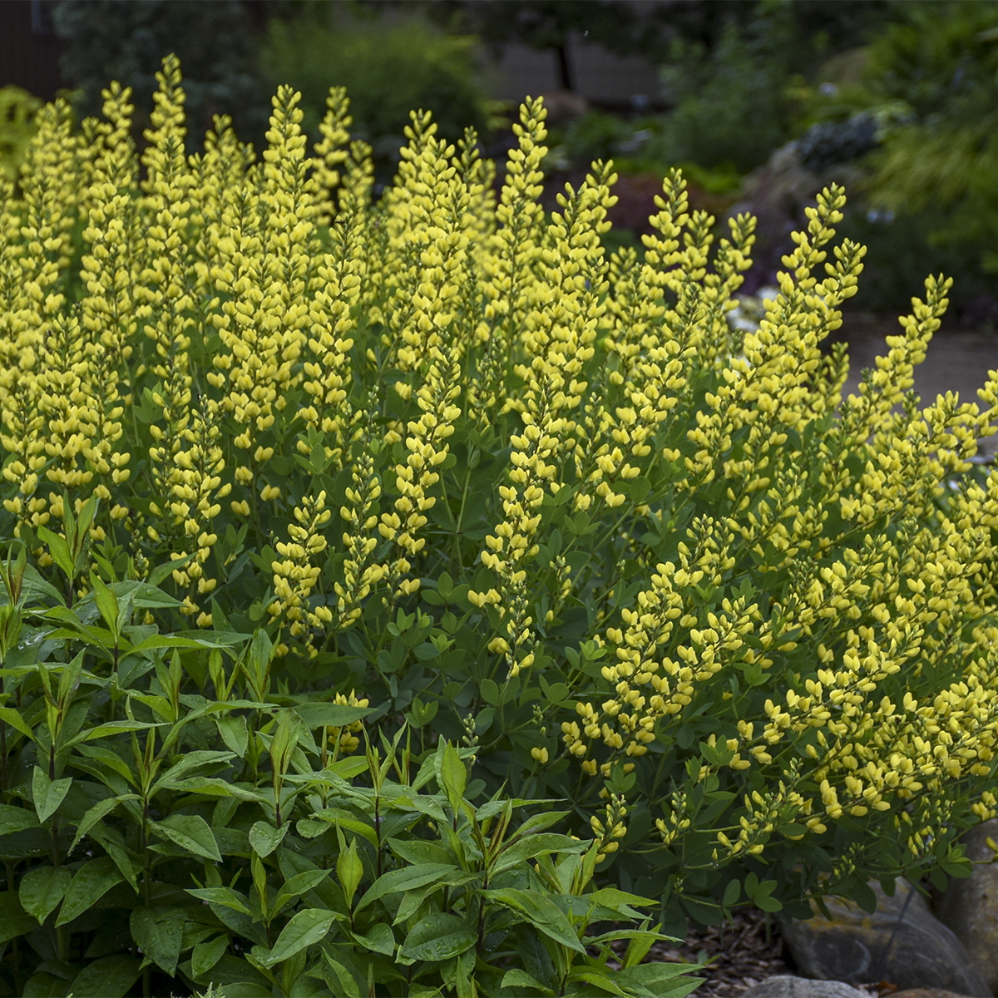
New Perennial
Beamsville, ON
NATIVAR’
Baptisia AMERICAN GOLDFINCH (False Indigo)
Photo Courtesy of Walters Gardens, Inc.

Slide 22
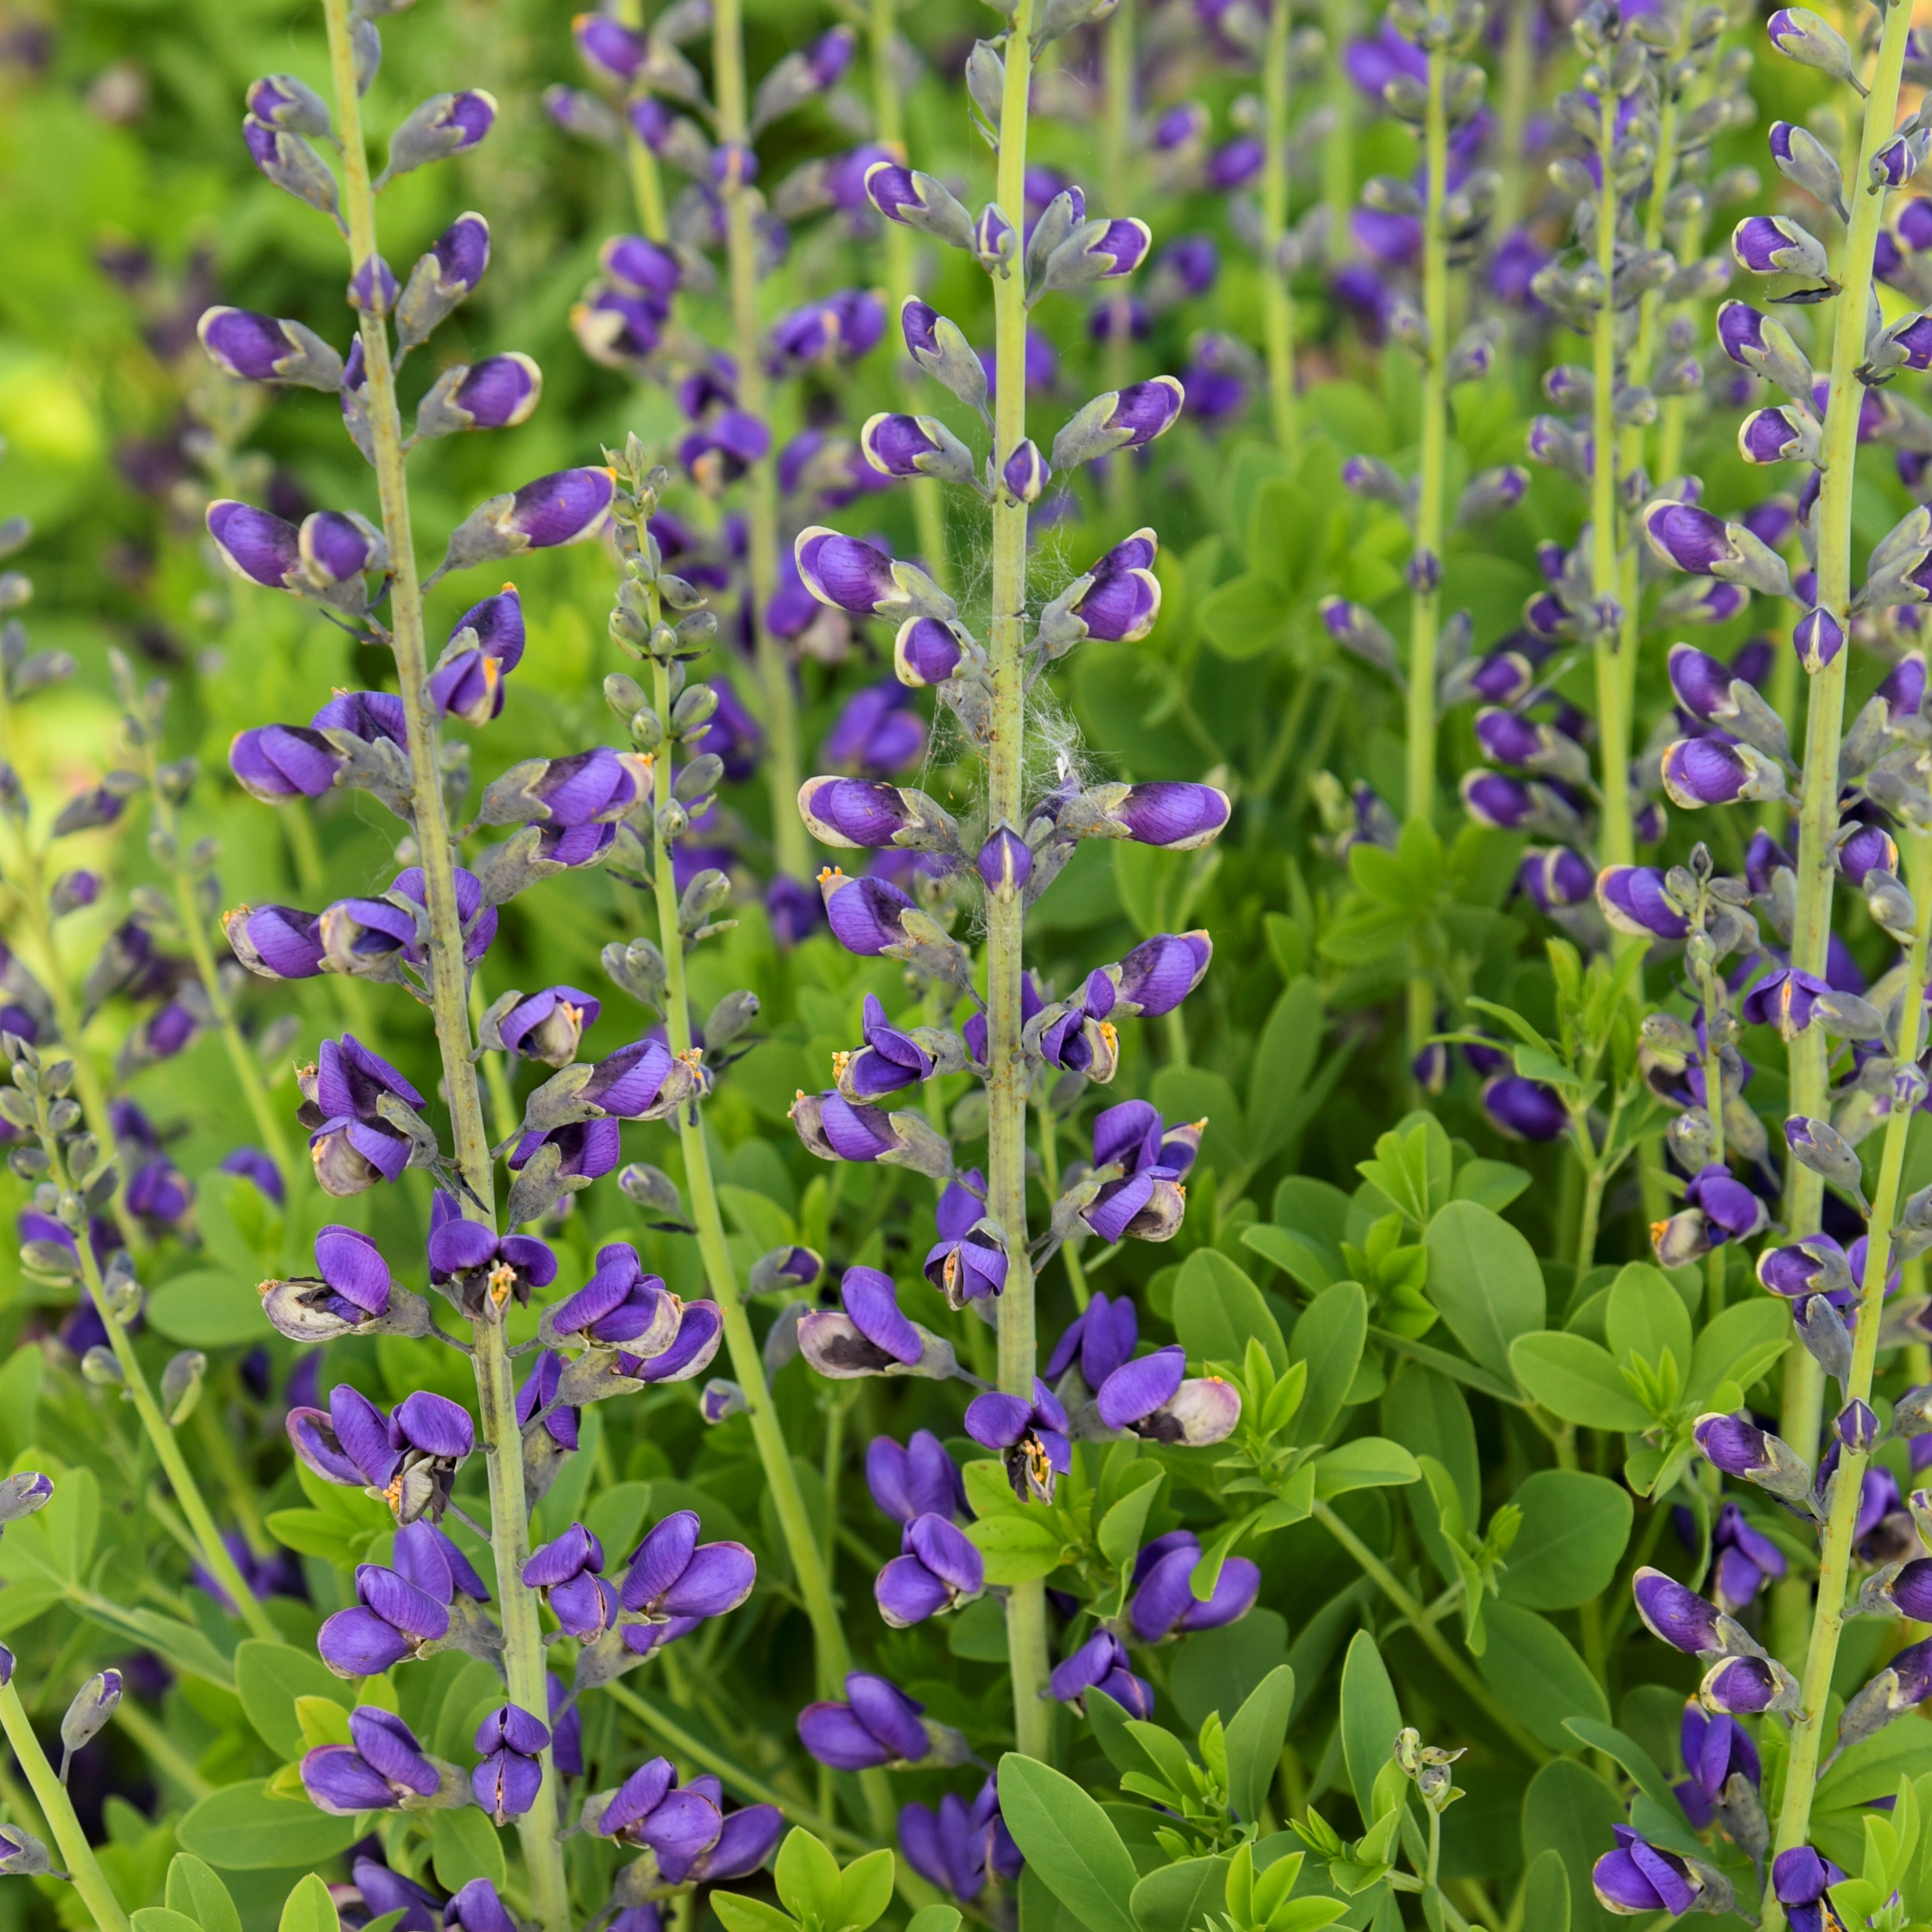
New Perennial
Beamsville, ON
NATIVAR’
Baptisia PERIWINKLE POPSICLE (False Indigo)
Photo Courtesy of Walters Gardens, Inc.

Slide 23
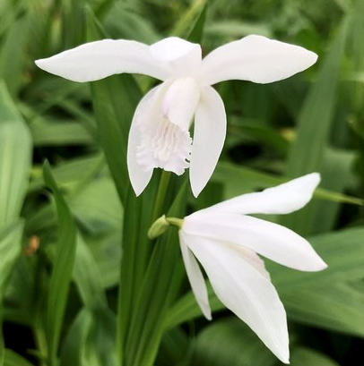
New Perennial
Beamsville, ON
NATIVE
Bletilla striata ALBA (Chinese Ground Orchid)

Slide 24
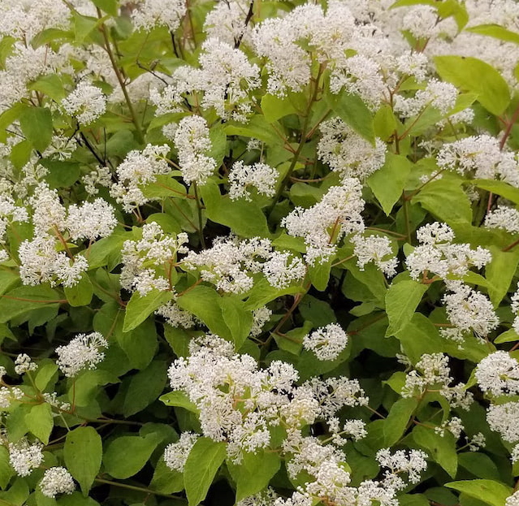
New Shrub
Beamsville, ON
NATIVE
Ceanothus americanus (New Jersey Tea)

Slide 25
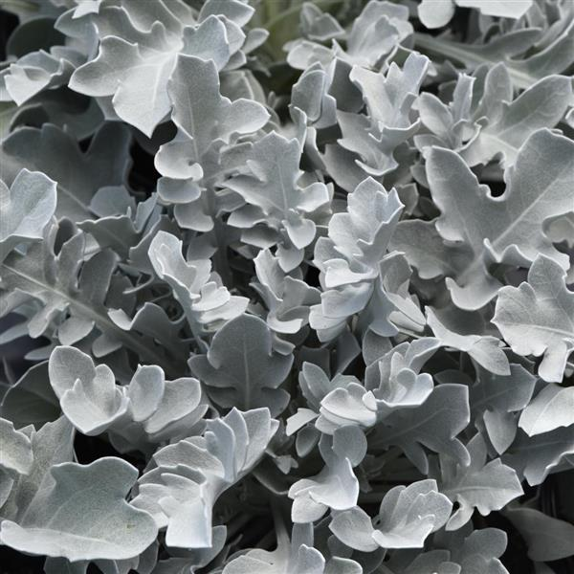
New Perennial
Beamsville, ON
Centaurea
ragusina SILVER SWIRL (Snowflake Dusty Miller)
Photo Courtesy of Ball Horticultural Company

Slide 26
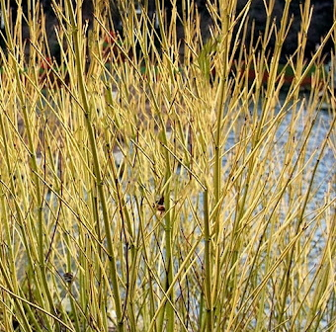
New Shrub
Beamsville, ON
Cornus alba BUD’S YELLOW (Yellowtwig Dogwood)

Slide 27
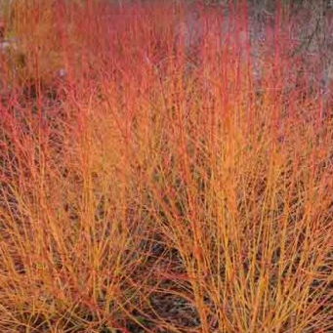
New Shrub
Beamsville, ON
Cornus
sanguinea MIDWINTER FIRE (Bloodtwig Dogwood)

Slide 28
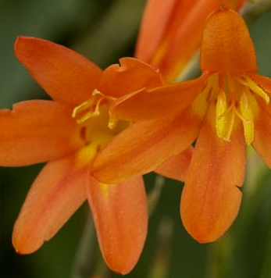
New Perennial
Beamsville, ON
Crocosmia ABUNDANT JOY (Montbretia)

Slide 29
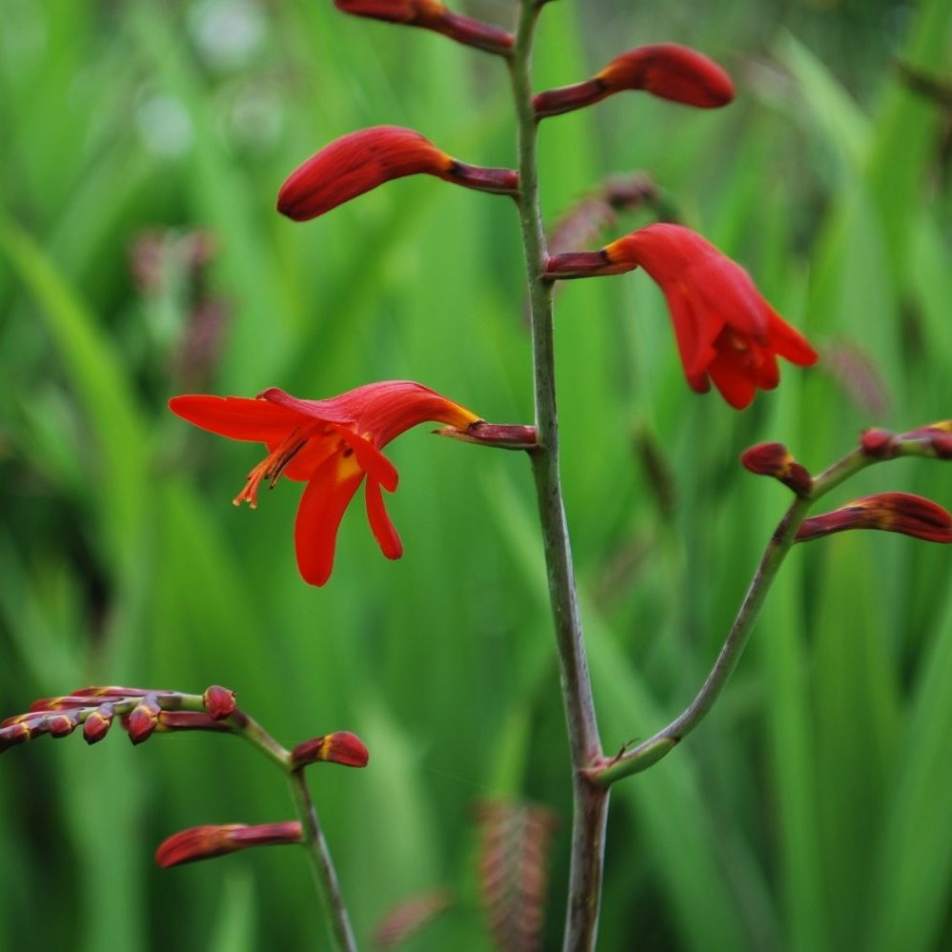
New Perennial
Beamsville, ON
Crocosmia EMBERGLOW (Montbretia)

Slide 30
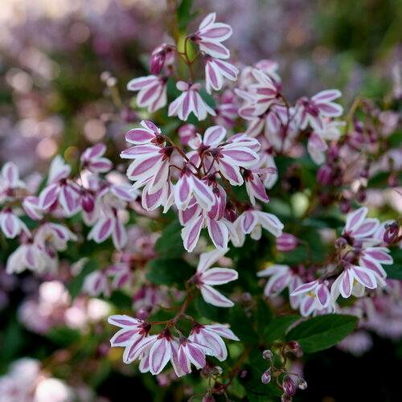
New Shrub
Beamsville, ON
Deutzia YUKI KABUKI™ 'NCDX3’
Photo Courtesy of Proven Winners

Slide 31
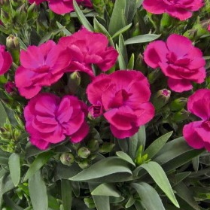
New Perennials
Beamsville, ON
Dianthus
caryophyllus PEAMAN VIOLET (Pinks)

Slide 32
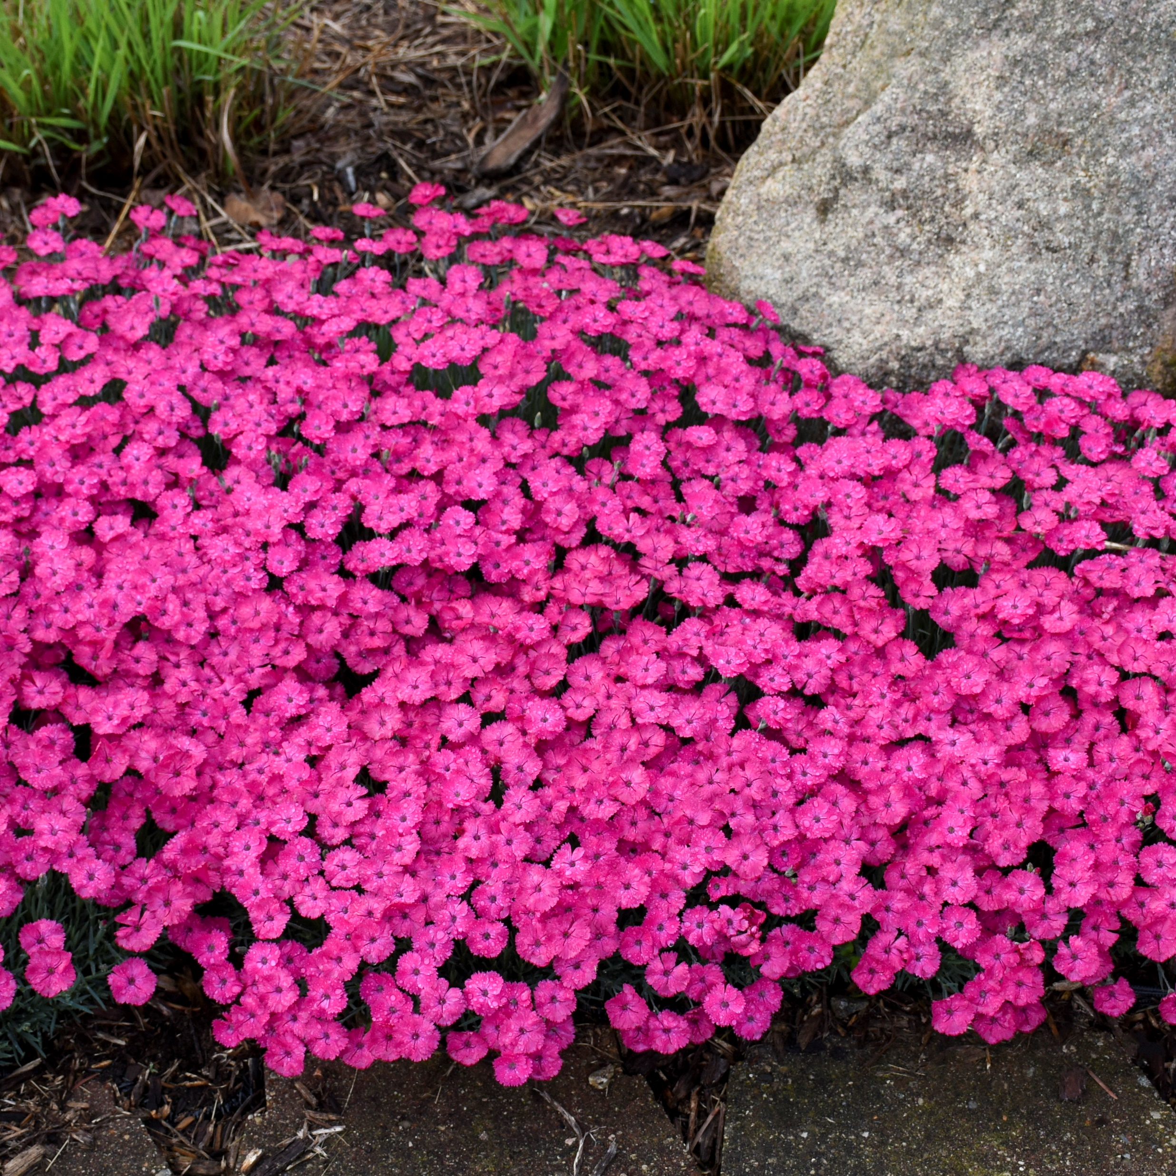
New Perennial
Beamsville, ON
Dianthus PAINT THE TOWN MAGENTA
(Pinks)
Photo Courtesy of Walters Gardens, Inc.

Slide 33
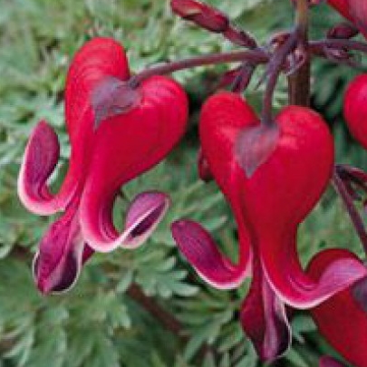
New Perennial
Beamsville, ON
Dicentra RED FOUNTAIN
(Fern-Leaf Bleeding Heart)

Slide 34
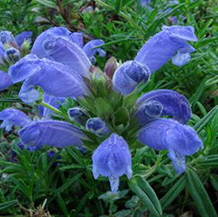
New Perennial
Beamsville, ON
Dracocephalum
ruyschiana BLUE DRAGON
(Dragonhead)

Slide 35
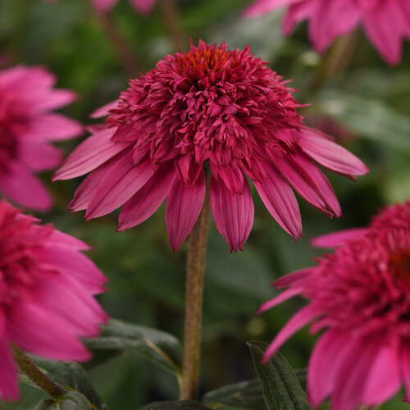
New Perennial
Beamsville, ON
Echinacea DOUBLE SCOOP™ WATERMELON DELUXE (Coneflower)
Photo Courtesy of Proven Winners

Slide 36
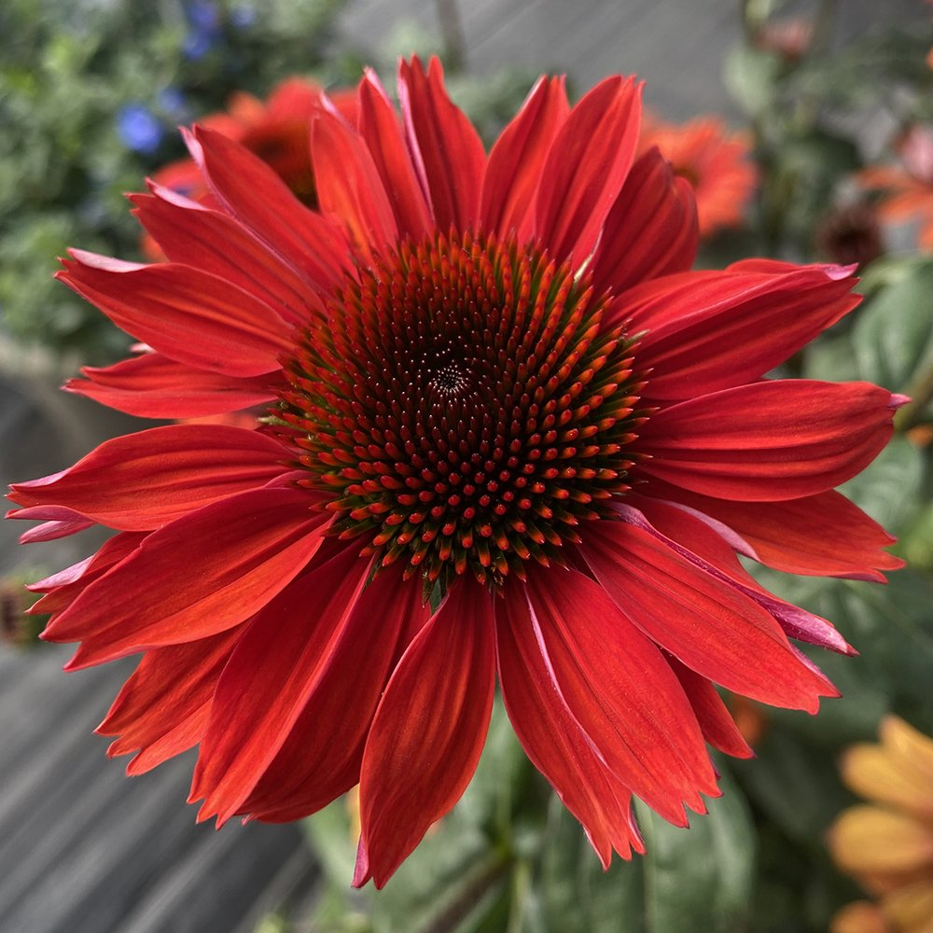
New Perennial
Beamsville, ON
Echinacea PANAMA™ RED (Coneflower)
Photo Courtesy of THINK PLANTS

Slide 37
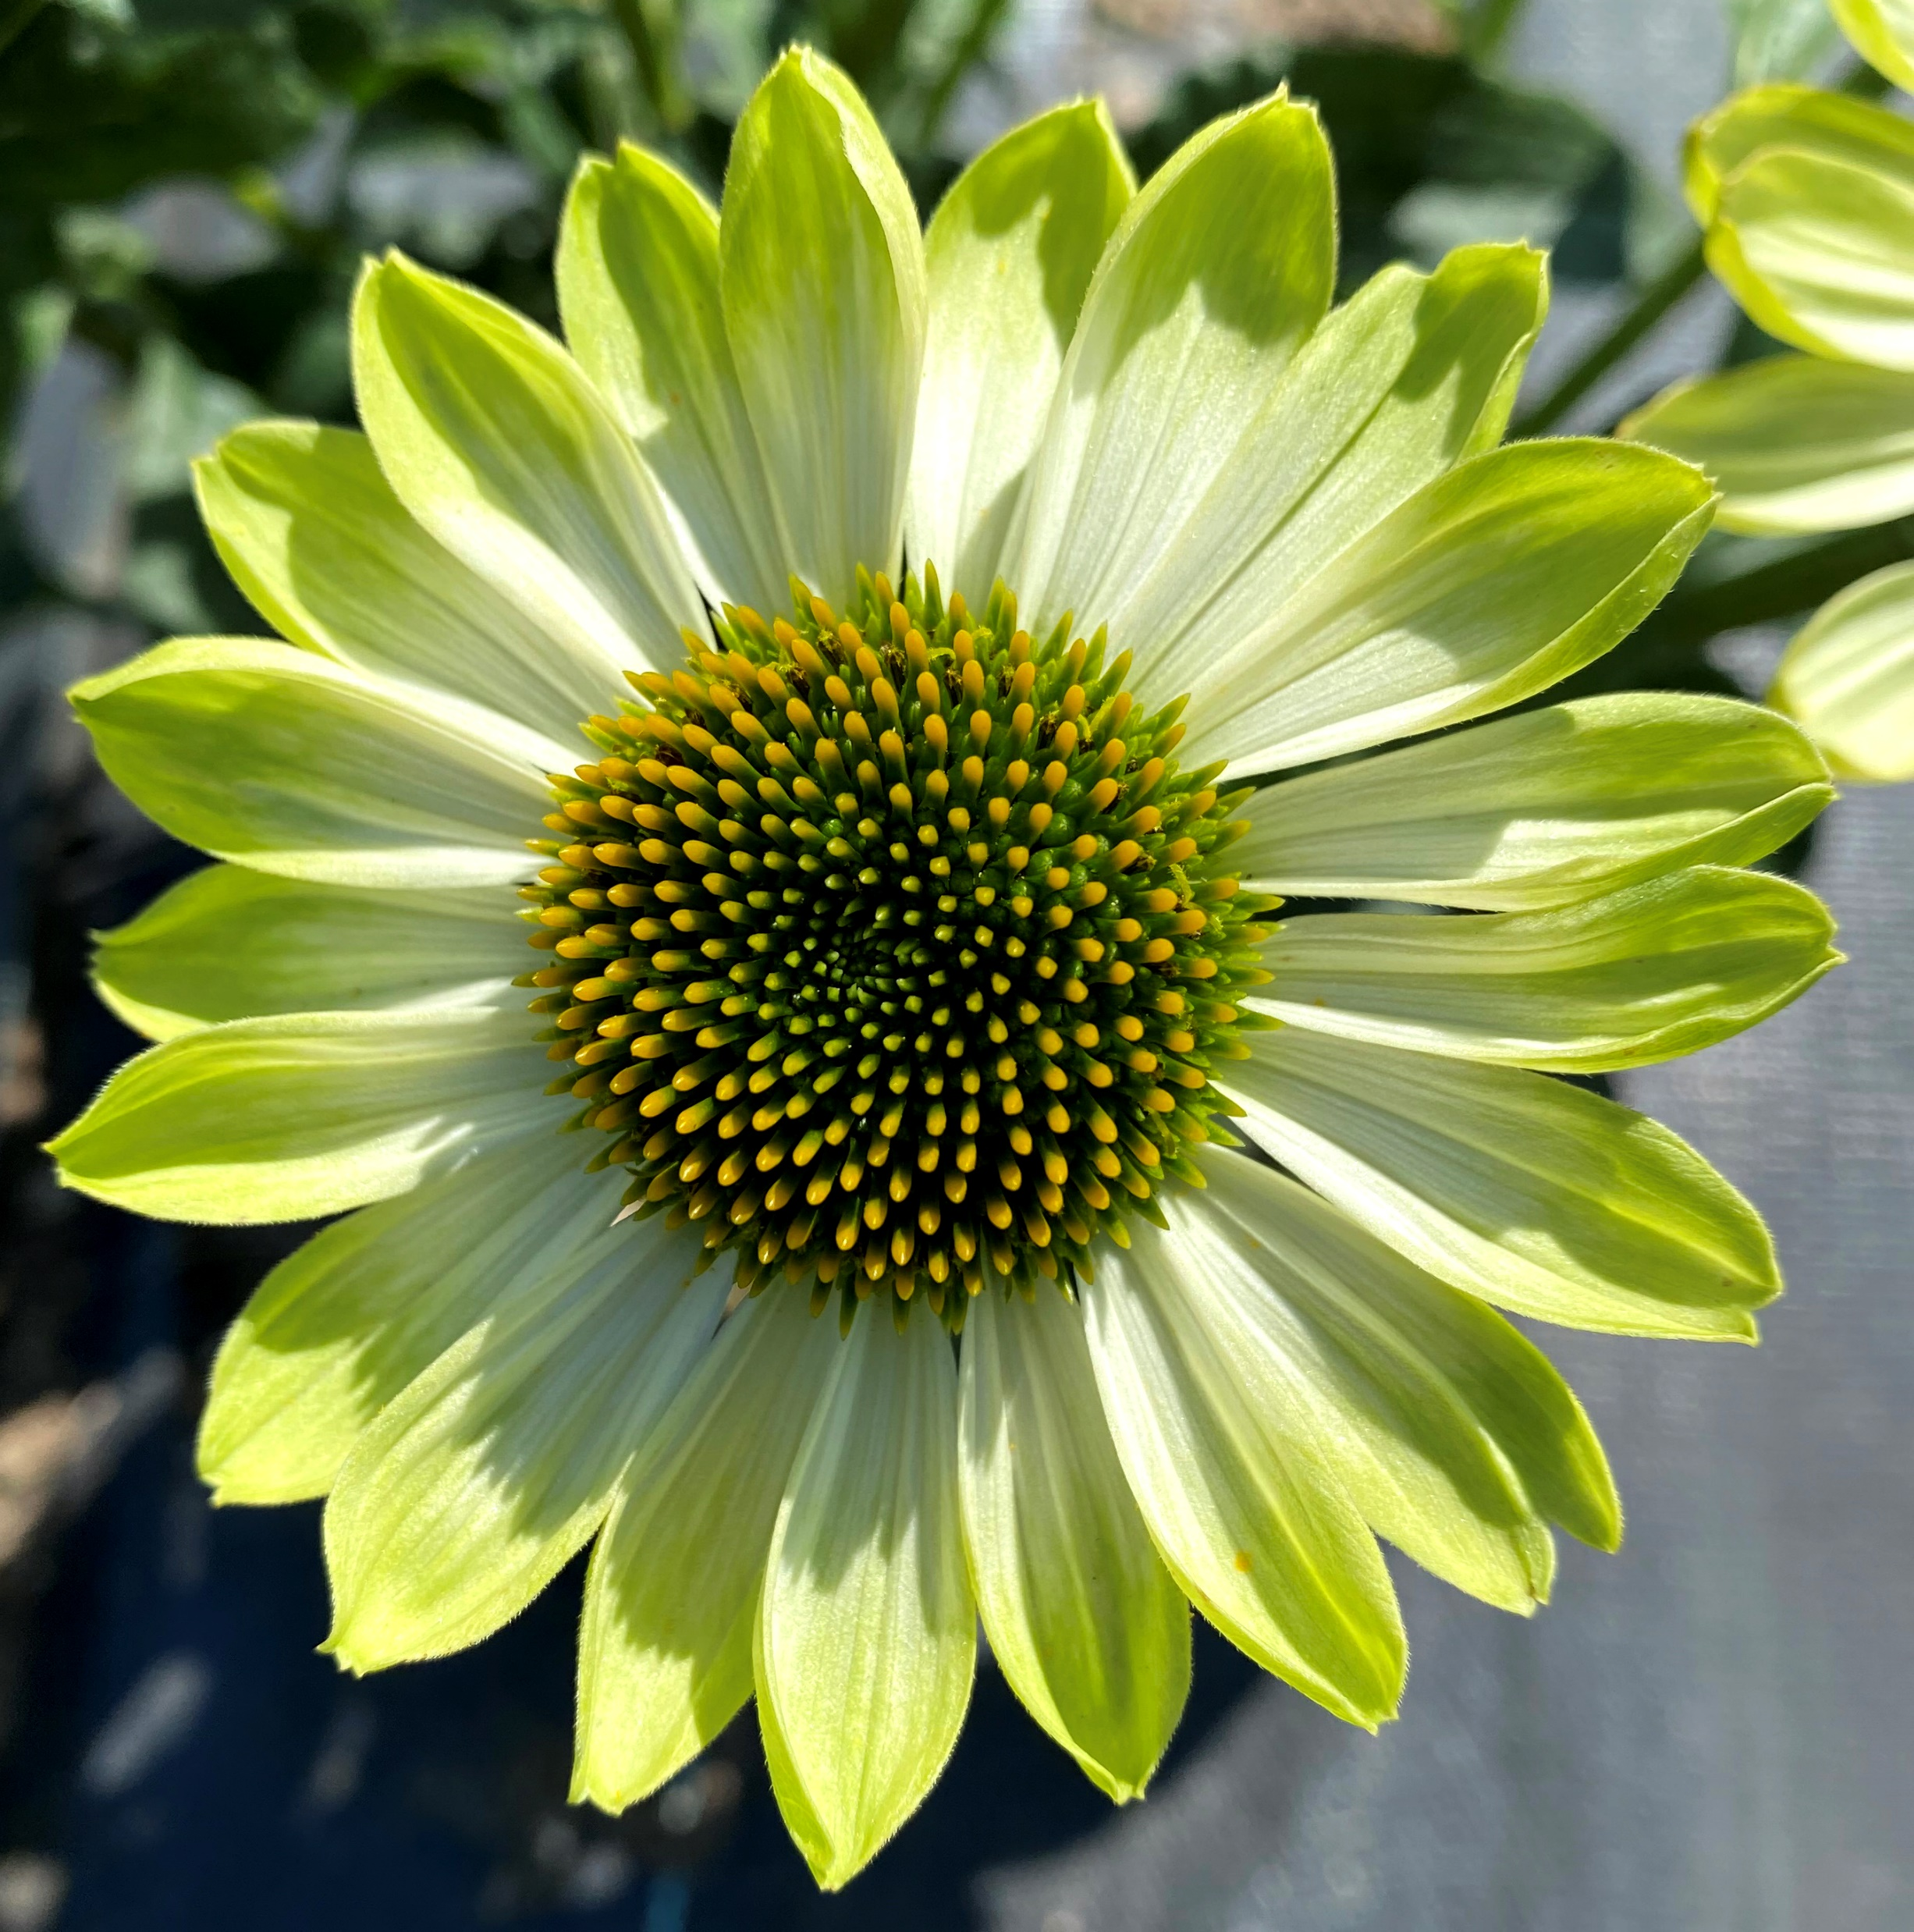
New Perennial
Beamsville, ON
Echinacea PRIMA™ LIME (Coneflower)
Photo Courtesy of Terra Nova® Nurseries, Inc.

Slide 38
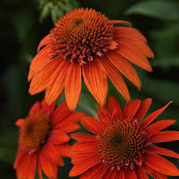
New Perennial
Beamsville, ON
Echinacea SOMBRERO™ FIESTA ORANGE
(Coneflower)
Photo Courtesy of Darwin Perennials

Slide 39
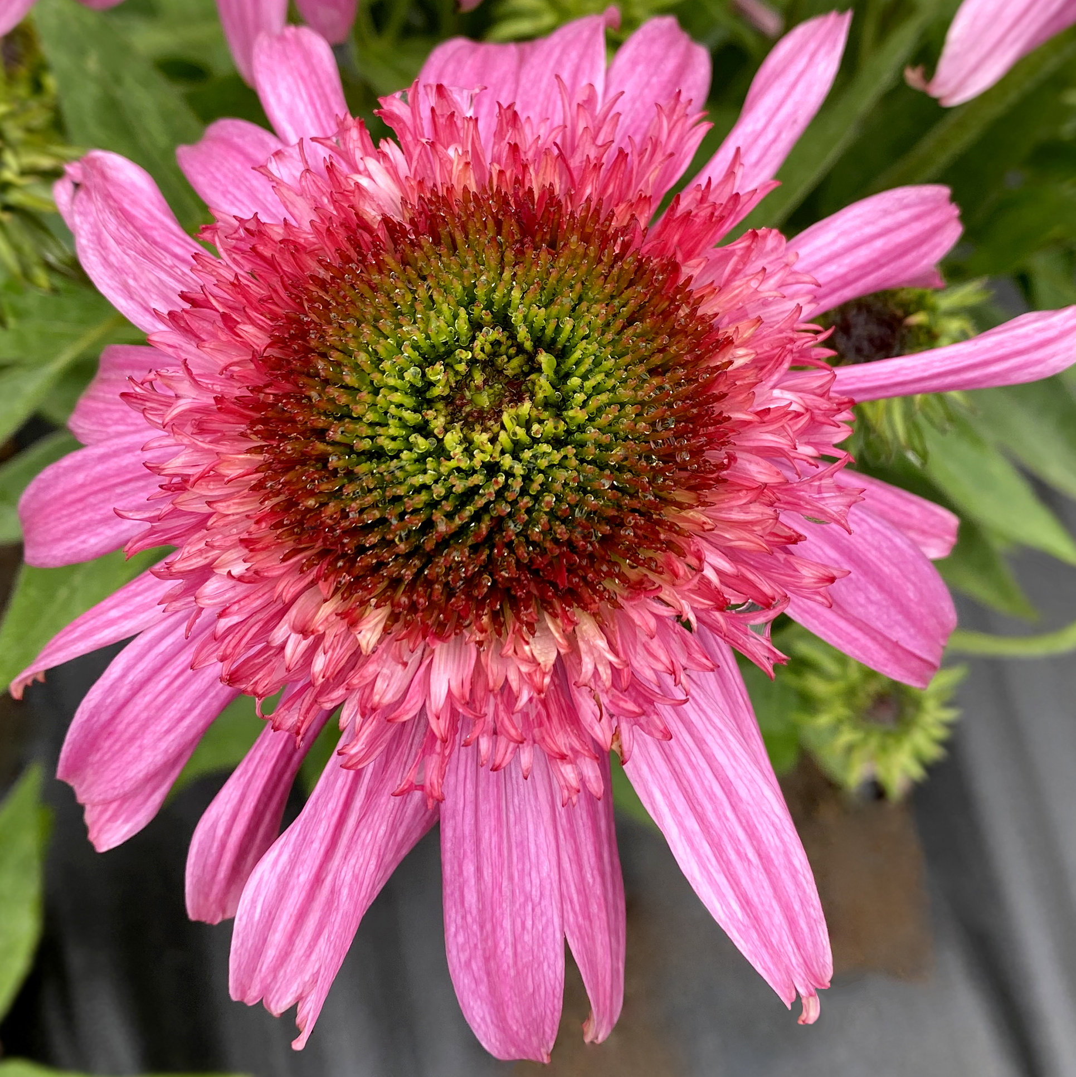
New Perennial
Beamsville, ON
Echinacea SUNDIAL™ PINK
(Coneflower)
Photo Courtesy of Terra Nova® Nurseries, Inc.

Slide 40
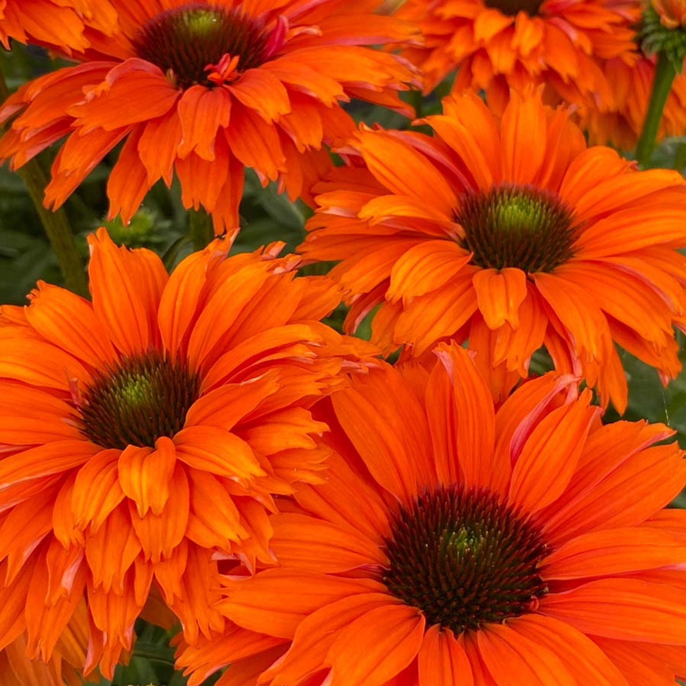
New Perennial
Beamsville, ON
Echinacea SUNSEEKERS® MINEOLA
(Coneflower)
Photo Courtesy of Emerald Coast Growers

Slide 41
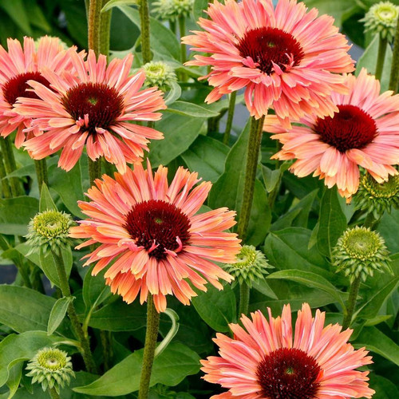
New Perennial
Beamsville, ON
Echinacea SUNSEEKERS® RAINBOW
(Coneflower)
Photo Courtesy of Emerald Coast Growers

Slide 42
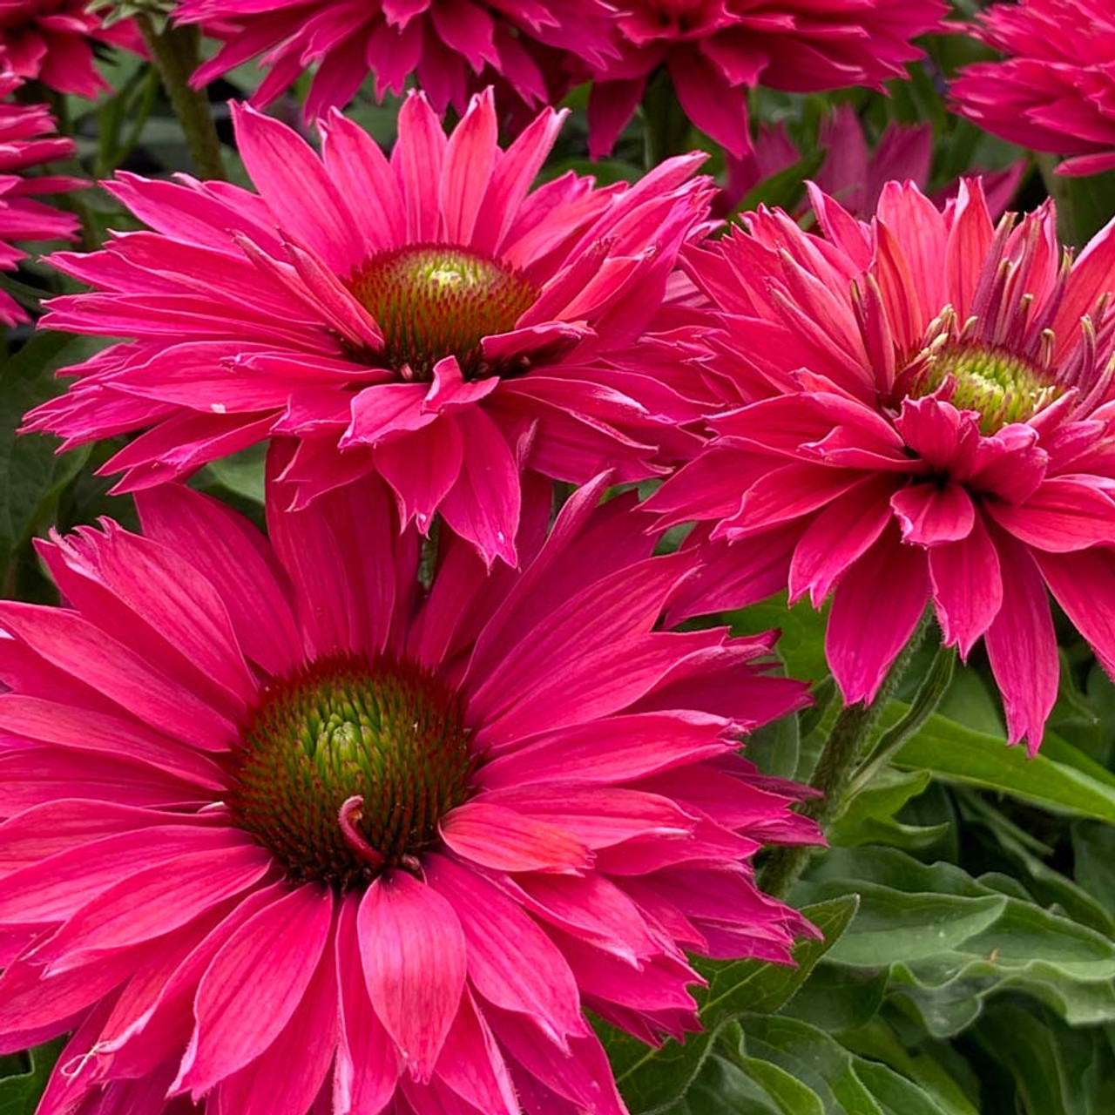
New Perennial
Beamsville, ON
Echinacea SUNSEEKERS® SWEET FUCHSIA
(Coneflower)
Photo Courtesy of Emerald Coast Growers

Slide 43
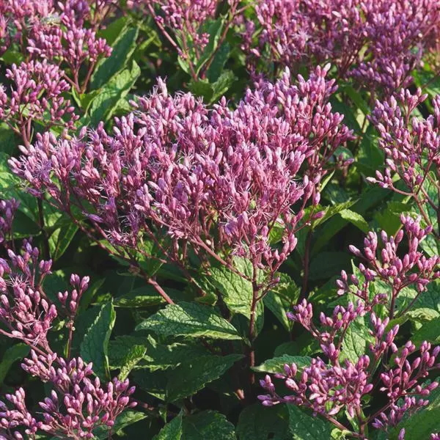
New Perennial
Beamsville, ON
Eupatorium purpureum
EUPHORIA™ RUBY
'FLOREUPRE1’
(Joe-Pye Weed)
Photo Courtesy of Darwin Perennials

Slide 44
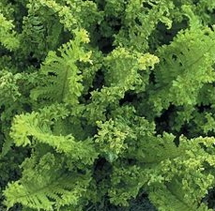
New Perennial
Beamsville, ON
Fern
Dryopteris filix-mas CRISPA CRISTATA (Crested Male Fern)

Slide 45
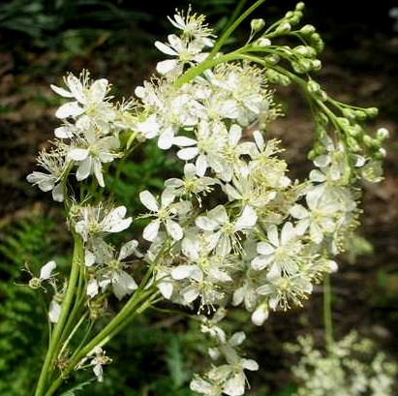
New Perennial
Beamsville, ON
Filipendula
vulgaris PLENA (Meadowsweet)

Slide 46
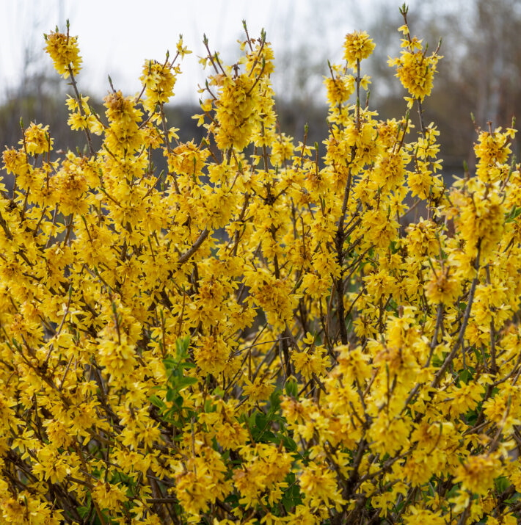
New Shrub
Beamsville, ON
Forsythia SPRING FLING® (Pinks)
Photo Courtesy of First Editions

Slide 47
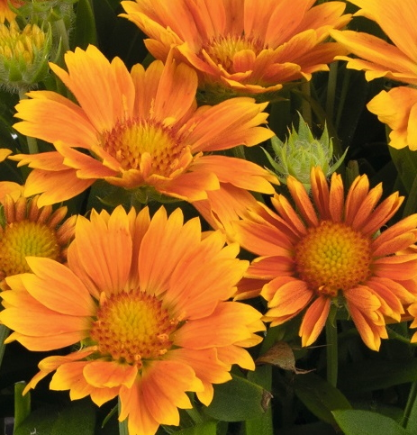
New Perennial
Beamsville, ON
Gaillardia
aristata SPINTOP™ MANGO
(Blanket Flower)

Slide 48
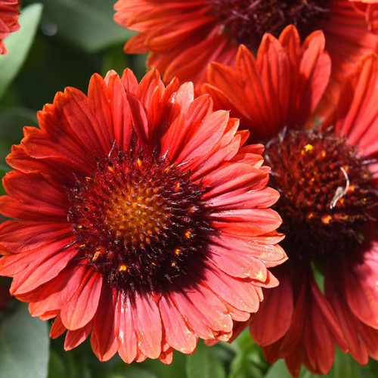
New Perennial
Beamsville, ON
Gaillardia
aristata SPINTOP™ MARIACHI RED SKY (Blanket Flower)
Photo Courtesy of Emeral Coast Growers

Slide 49
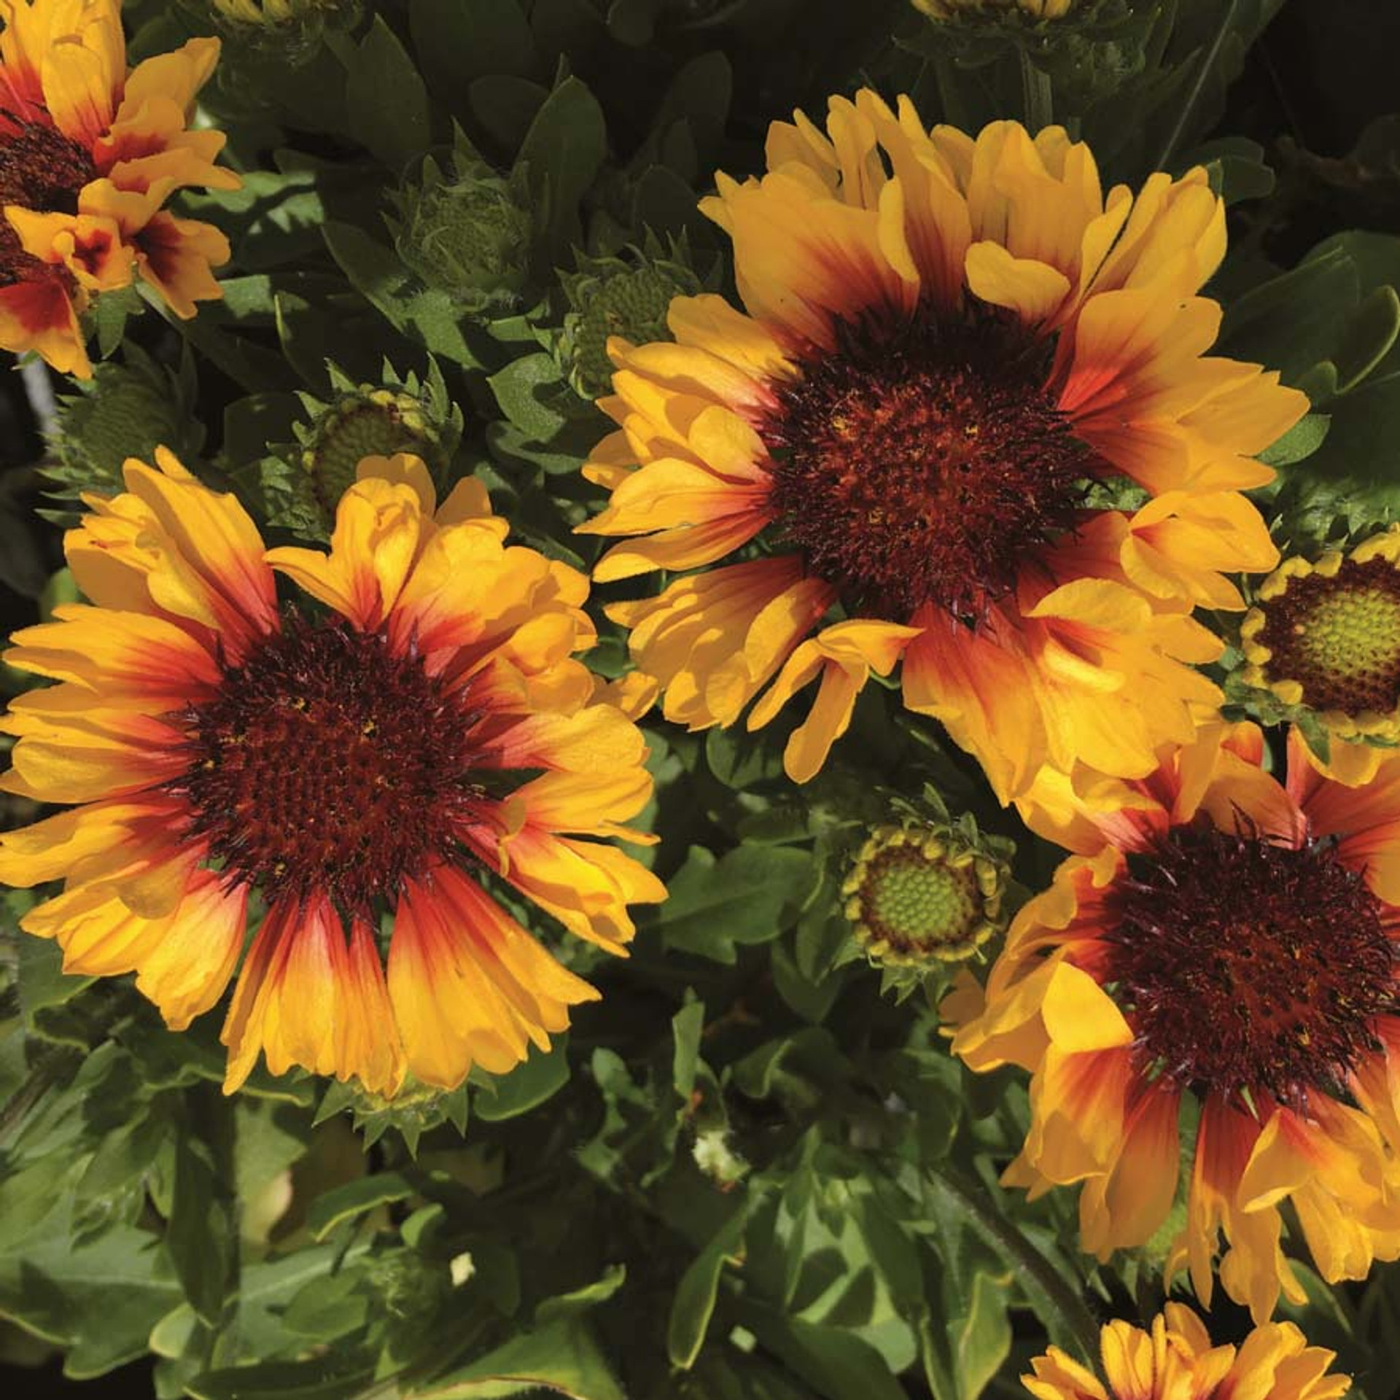
New Perennial
Beamsville, ON
Gaillardia
aristata SPINTOP™ RED STARBURST (Blanket Flower)
Photo Courtesy of Emeral Coast Growers

Slide 50
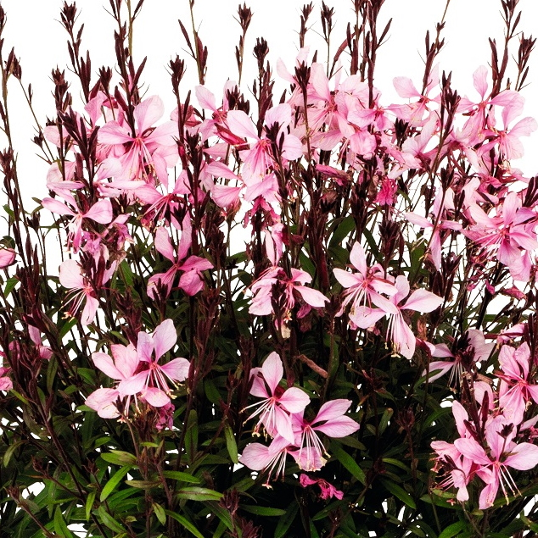
New Perennial
Beamsville, ON
Gaura MONARCH PINK
(Wand Flower)

Slide 51
New Perennial
Beamsville, ON
Gaura MONARCH WHITE
(Wand Flower)

Slide 52
New Perennial
Beamsville, ON
Geranium sanguineum
PINK SUMMER (Cranesbill)

Slide 53
New Perennial
Beamsville, ON
Geum TEMPO™ CORAL
(Avens)
Photo Courtesy of Terra Nova® Nurseries, Inc.

Slide 54
New Perennial
Beamsville, ON
Geum TEMPO™ ORANGE
(Avens)
Photo Courtesy of Terra Nova® Nurseries, Inc.

Slide 55
New Perennial
Beamsville, ON
Geum TEMPO™ ROSE
(Avens)
Photo Courtesy of Terra Nova® Nurseries, Inc.

Slide 56
New Perennial
Beamsville, ON
Geum TEMPO™ YELLOW
(Avens)
Photo Courtesy of Terra Nova® Nurseries, Inc.

Slide 57
New Perennial
Beamsville, ON
NATIVE
Gillenia
trifoliata
(Bowman’s Root)

Slide 58
New Perennial
Beamsville, ON
Acornus gramineus
OGON
(Golden Variegated Sweet Flag)
Photo Courtesy of Hoffman Nursery, Inc.

Slide 59
New Perennial
Beamsville, ON
NATIVE
Carex appalachica
(Appalachian Sedge)
Photo Courtesy of Hoffman Nursery, Inc.

Slide 60
New Perennial
Beamsville, ON
NATIVE
Carex crinita
(Fringed Sedge)
Photo Courtesy of Hoffman Nursery, Inc.

Slide 61
New Perennial
Beamsville, ON
Molina caerulea
Moorhexe
(Moor Grass)
Photo Courtesy of Norview Gardens Ltd.

Slide 62
New Perennial
Beamsville, ON
Pennisetum alopecuroides
LEMON SQUEEZE
(Fountain Grass)
Photo Courtesy of Walter Gardens Inc.

Slide 63
New Perennial
Beamsville, ON
NATIVE
Schizachyrium
scoparium
HA HA TONKA
(Little Bluestem)
Photo Courtesy of Hoffman Nursery Inc.

Slide 64
New Perennial
Beamsville, ON
Schizachyrium
scoparium
JAZZ
(Little Bluestem)
Photo Courtesy of Greenleaf Nursery

Slide 65
New Perennial
Beamsville, ON
NATIVE
Schizachyrium
scoparium
LITTLE RED FOX
(Little Bluestem)
Photo Courtesy of Emerald Coast Growers

Slide 66
New Perennial
Beamsville, ON
NATIVE
Schizachyrium
scoparium
SANDHILL
(Little Bluestem)
Photo Courtesy of Emerald Coast Growers

Slide 67
New Perennial
Beamsville, ON
NATIVE
Sporobolus heterolepis
GONE WITH THE WIND
(Prairie Dropseed)
Photo Courtesy of Walters Gardens, Inc.

Slide 68
New Annual
Beamsville, ON
Hedychium
TAHITIAN FLAME (Variegated ginger Lily)
Photo Courtesy of Terra Nova ® Nurseries, Inc.

Slide 69
New Perennial
Beamsville, ON
Heliopsis
Helianthoides var. scabra
LUNA ROJA (False Sunflower)
Photo Courtesy of Paridon Horticultural Ltd.

Slide 70
New Perennial
Beamsville, ON
Helleborus CALIFORNIA DREAMING
(Honeymoon Series) (Lenten Rose)
Photo Courtesy of Walters Gardens, Inc.

Slide 71
New Perennial
Beamsville, ON
Helleborus CONFETTI CAKE
(Wedding Party Series) (Lenten Rose)
Photo Courtesy of Walters Gardens, Inc.

Slide 72
New Perennial
Beamsville, ON
Helleborus x grandorfensis
HGC® ICE N' ROSES NIGHTINGALE (Lenten Rose)

Slide 73
New Perennial
Beamsville, ON
Helleborus SHOTGUN WEDDING
(Wedding Party Series) (Lenten Rose)
Photo Courtesy of Walters Gardens, Inc.

Slide 74
New Perennial
Beamsville, ON
Heuchera
MAHOGANY MONSTER
(Coral Bells)
Photo Courtesy of Walters Gardens, Inc.

Slide 75
New Perennial
Beamsville, ON
Heuchera PEACH SMOOTHIE (Coral Bells)
Photo Courtesy of Terra Nova® Nurseries, Inc.

Slide 76
New Perennial
Beamsville, ON
Hibiscus COOKIES AND CREAM
(Summerific® Collection)
(Rose Mallow)
Photo Courtesy of Walters Gardens, Inc.

Slide 77
New Perennial
Beamsville, ON
Hibiscus MARSHMALLOW MOON
(Rose Mallow)
Photo Courtesy of Walters Gardens, Inc.

Slide 78
New Shrub
Beamsville, ON
Hibiscus
syriacus STARBLAST CHIFFON™
(Rose Of Sharon)
Photo Courtesy of Proven Winners

Slide 79
New Perennial
Beamsville, ON
Hibiscus
WATERMELON RUFFLES
(Rose Mallow)
Photo Courtesy of Walters Gardens, Inc.

Slide 80
New Perennial
Beamsville, ON
Hosta
GIGANTOSAURUS (Extra Large)
Photo Courtesy of Walters Gardens, Inc.

Slide 81
New Perennial
Beamsville, ON
Hosta
LONE STAR (Large)
Photo Courtesy of Walters Gardens, Inc.

Slide 82
New Perennial
Beamsville, ON
Hosta
SOUND OF MUSIC (Extra Large)
Photo Courtesy of Walters Gardens, Inc.

Slide 83
New Perennial
Beamsville, ON
Hosta
YELLOW POLKA DOT BIKINI (Small)
Photo Courtesy of Paridon Horticultural Ltd.

Slide 84
New Shrub
Beamsville, ON
Hydrangea macrophylla ECLIPSE® 'Bailmacseven’
(Bigleaf Hydrangea)
Photo Courtesy of Bailey® Nurseries

Slide 85
New Shrub
Beamsville, ON
Hydrangea macrophylla SOUL MATE™ 'Hokomasoma’
(Mophead Hydrangea)
Photo Courtesy of Bloomin’ Easy®

Slide 86
New Shrub
Beamsville, ON
Hydrangea macrophylla WEE BIT INNOCENT™ ’SMNHMC’
(Bigleaf Hydrangea)
Photo Courtesy of Proven Winners

Slide 87
New Shrub
Beamsville, ON
Hydrangea paniculata BOUNCY
(Panicle Hydrangea)

Slide 88
New Shrub
Beamsville, ON
Hydrangea paniculata TINY QUICK FIRE®
(Panicle Hydrangea)
Photo Courtesy of Spring Meadow

Slide 89
New Perennial
Beamsville, ON
Iberis
sempervirens CANDY SORBET (Candytuft)

Slide 90
New Perennial
Beamsville, ON
Iris
gemanica BLUE TRILL (Tall Bearded Iris)
Photo Courtesy of Schreiners Irises

Slide 91
New Perennial
Beamsville, ON
Iris
gemanica CALIGULA (Tall Bearded Iris)

Slide 92
New Perennial
Beamsville, ON
Iris
gemanica EDGE OF WINTER (Tall Bearded Iris)

Slide 93
New Perennial
Beamsville, ON
Iris
gemanica LEMON POP (Tall Bearded Iris)

Slide 94
New Perennial
Beamsville, ON
Iris
gemanica MIDWEST STAR (Tall Bearded Iris)

Slide 95
New Perennial
Beamsville, ON
Iris
gemanica SNOW MOUND (Tall Bearded Iris)

Slide 96
New Perennial
Beamsville, ON
Iris
gemanica SPRING WINE (Tall Bearded Iris)

Slide 97
New Perennial
Beamsville, ON
Isotoma
fluviatilis (Blue Star Creeper)

Slide 98
New Perennial
Beamsville, ON
Kniphofia GLOWSTICK
(Red-Hot Poker)
Photo Courtesy of Emerald Coast Growers

Slide 99
New Shrub
Beamsville, ON
Kolkwitzia
amabilis JOLENE JOLENE (Beautybush)
Photo Courtesy of Proven Winners

Slide 100
New Perennial
Beamsville, ON
Lavandula
angustifolia LA DIVA ETERNAL FRAGRANCE (English Lavender)

Slide 101
New Shrub
Beamsville, ON
Lonicera nitida
THUNDERBOLT®
‘GOLDEN GLOW’ (Box Honeysuckle)
Photo Courtesy of Bloomin’ Easy

Slide 102
New Perennial
Beamsville, ON
Lynchnis chalcedonica
(Maltese Cross)

Slide 103
New Perennial
Beamsville, ON
NATIVE
Maianthemum racemosum (False Soloman’s Seal)

Slide 104
New Perennial
Beamsville, ON
Malva
sylvestris ZEBRINA
(Hollyhock Mallow, Zebra Mallow)
Photo Courtesy of Walters Gardens, Inc.

Slide 105
New Perennial
Beamsville, ON
Mangave MISSION TO MARS
(Mangave)
Photo Courtesy of Walters Gardens, Inc.

Slide 106
New Perennial
Beamsville, ON
Nepeta KITTEN AROUND
(Catmint)
Photo Courtesy of Walters Gardens, Inc.

Slide 107
New Perennial
Beamsville, ON
NATIVE
Oenothera
biennis (Common Evening Primrose)

Slide 108
New Perennial
Beamsville, ON
Oredenia FUSION OF FIRE
(Oredenia)
Photo Courtesy of Walters Gardens, Inc.

Slide 109
New Perennial
Beamsville, ON
^{COMING SOON}
Paeonia
lactiflora BOUQUET PERFECT (Garden Peony)

Slide 110
New Perennial
Beamsville, ON
^{COMING SOON}
Paeonia
lactiflora PETER BRAND (Garden Peony)

Slide 111
New Perennial
Beamsville, ON
^{COMING SOON}
Paeonia
lactiflora SUNNY GIRL (Garden Peony)

Slide 112
New Perennial
Beamsville, ON
^{COMING SOON}
Paeonia
PURPLE SENSATION (Intersectional (Itoh) Peony)

Slide 113
New Perennial
Beamsville, ON
Parthenocissus quinquefolia
(Virginia Creeper)

Slide 114
New Perennial
Beamsville, ON
Penstemon
barbatus ROCK CANDY® LIGHT PINK
‘NovapenLig’
(Beard Tongue)
Photo Courtesy of Ball Horticultural Company

Slide 115
New Perennial
Beamsville, ON
Penstemon
barbatus ROCK CANDY® PURPLE
‘Balrocurp’
(Beard Tongue)
Photo Courtesy of Proven Winners

Slide 116
New Perennial
Beamsville, ON
Perovskia
atriplicifolia CRAZY BLUE
(Russian Sage)
Photo Courtesy of Ball Horticultural Company

Slide 117
New Shrub
Beamsville, ON
Philadelphus
coronarius ILLUMINATI SPICE™ 'SMNPSDW’ (Mock Orange)
Photo Courtesy of Proven Winners

Slide 118
New Perennial
Beamsville, ON
Phlox
Glaberrima ssp. Interior (Smooth Phlox)

Slide 119
New Perennial
Beamsville, ON
Phlox
subulata
SCARLET FLAME (Moss Phlox)
Photo Courtesy of Paridon Horticultural Ltd.

Slide 120
New Shrub
Beamsville, ON
Physocarpus
opulifolius CALICO KITTY™
‘AuntieB’ (Ninebark)
Photo Courtesy of Bloomin' Easy®

Slide 121
New Shrub
Beamsville, ON
Physocarpus
opulifolius COUGAR CUB™
‘SueCKat’ (Ninebark)
Photo Courtesy of Bloomin' Easy®

Slide 122
New Shrub
Beamsville, ON
Physocarpus
opulifolius SAVANNAH SUNSET™
‘LP1’ (Ninebark)
Photo Courtesy of Bloomin' Easy®

Slide 123
New Perennial
Beamsville, ON
Platycodon
grandiflorus POP STAR™
PINK (Balloon Flower)
Photo Courtesy of Paridon Horticultural Ltd.

Slide 124
New Perennial
Beamsville, ON
NATIVE
Podophyllum
peltatum (May Apple)

Slide 125
New Shrub
Beamsville, ON
Potentilla
fruticosa BELLA SOL®
‘Hachdon’
(Bush Cinquefoil)
Photo Courtesy of Bloomin' Easy®

Slide 126
New Shrub
Beamsville, ON
Potentilla
nepalensis GIBSON’S SCARLET
(Cinquefoil)

Slide 127
New Broadleaf Evergreen
Beamsville, ON
Rhododendron
HOLDEN’S PEACH™
^{‘HoldenRhodo213’}
(Elepidote)
Photo Courtesy of Briggs Nursery

Slide 128
New Broadleaf Evergreen
Beamsville, ON
Rhododendron
BLOOMBUX® BLUSH
^{‘Microhirs3’}
(Bloombux Blush Rhododendron)
Photo Courtesy of Bloomin' Easy®

Slide 129
New Broadleaf Evergreen
Beamsville, ON
Rhododendron
BLOOMBUX® MAGENTA
^{‘Microhirs9’}
(Bloombux Magenta Rhododendron)

Slide 130
New Broadleaf Evergreen
Beamsville, ON
Rhododendron
YAKU PRINCE
(Yakushimanum Hybrid)

Slide 131
New Perennial
Beamsville, ON
Roscoea
purpurea (Roscoe’s Lily)

Slide 132
New Small Fruit
Edibles
Beamsville, ON
Rubus
GLENCOE (Purple thornless Raspberry)

Slide 133
New Perennial
Beamsville, ON
Rudbeckia
fulgida GOLDBLITZ (Black-Eyed Susan)
Photo Courtesy of Emerald Coast Growers

Slide 134
New Shrub
Beamsville, ON
Sambucus
canadensis (American Black Elderberry)
Photo Courtesy of NVK Nurseries

Slide 135
New Perennial
Beamsville, ON
Sanguinaria
canadensis
(Bloodroot)

Slide 136
New Perennial
Beamsville, ON
Scabiosa
columbaria
NOVA®
DEW DROPS (Variegated Pincushion)
Photo Courtesy of Terra Nova® Nurseries, Inc.

Slide 137
New Perennial
Beamsville, ON
Scutellaria
incarna (Downy/Hoary Skullcap)
Photo Courtesy of NVK Nurseries

Slide 138
New Perennial
Beamsville, ON
Sempervivum STEEL APPEAL (Hens and Chicks)

Slide 139
New Perennial
Beamsville, ON
NATIVE
Sisyrinchium
nashii SUWANNEE (Blue-eyed Grass)

Slide 140
New Perennial
Beamsville, ON
NATIVE
Symphyotrichum
shortii (Short’s Aster)

Slide 141
New Perennial
Beamsville, ON
Symphytum
grandiflorum (Comfrey)

Slide 142
New Perennial
Beamsville, ON
NATIVE
Thalictrum
dioicum (Early Meadow Rue)

Slide 143
New Shrub
Beamsville, ON
NATIVE
Thuja
occidentalis NORTH POLE®
‘Art Boe’ (American Arborvitae)
Photo Courtesy of Spring Meadow

Slide 144
New Shrub
Beamsville, ON
NATIVE
Thuja
occidentalis FULL SPEED A HEDGE®
THIN MAN®
‘SMTOTM’ (Arborvitae)
Photo Courtesy of Spring Meadow

Slide 145
New Perennial
Beamsville, ON
Tricyrtis
hirta (Japanese Toad Lily)
Photo Courtesy of Van Noort Bulb Co. Ltd.

Slide 146
New Perennial
Beamsville, ON
NATIVE
Trillium grandiflorum
(White Trillium)

Slide 147
New Perennial
Beamsville, ON
Viola
cornuta HALO VIOLET (Violet)
Photo Courtesy of Darwin Perennials

Slide 148
New Perennial
Beamsville, ON
Viola
walteri SILVER GEM (Prostrate Blue Violet)
Photo Courtesy of North Creek Nurseries

Slide 149
New Perennial
Beamsville, ON
Veronica
longifolia SKYWARD™ PINK (Speedwell)
Photo Courtesy of Darwin Perennials

Slide 150
New Shrub
Beamsville, ON
Weigela
florida TOWERS OF FLOWERS® CHERRY
‘WG16-04’ (Weigela)

Slide 151
New Shrub
Beamsville, ON
Xanthorhiza
Simplicissima
(Yellow Root)

